Slide 1
Test Review
Objective:
SWBAT review for the physics test
Warm Up:
Write two things you need help with today
Write one thing you could help someone with today
Notes:
1

Slide 2
HW Review
Any questions?
Let’s go over answers
Please correct all wrong answers

Slide 3
Study Guide, Part 1 (10 minutes)
Complete the first side of the study guide
Mark out some questions

Slide 4
Acceleration due to Gravity
When something falls, it ACCELERATES because of the force of GRAVITY pulling on that object
Objects falling accelerate at a rate of 9.8 m/s/s

Slide 5
Acceleration Due to Gravity
To calculate the acceleration of a falling object, you would use 9.8 m/s/s
9.8 m/s/s x #seconds
You can multiply the length of time the object falls (in seconds) by 9.8
Example: A skydiver jumps from an airplane. What is his velocity after 4 seconds?

Slide 6
#12 on the Study Guide
Using your new knowledge, how might you solve this problem?
Hint hint…the bonus question on the test MIGHT involve acceleration due to gravity…

Slide 7
Bill Nye: Friction
Gather some background information on friction and “expert knowledge” from Bill
Answer ALL questions (found on the back of your homework sheet)
https://www.youtube.com/watch?v=nmnzLW6YoF0

Slide 8
Study Guide, Part 2 (15 minutes)
Answer the rest of the questions on your study guide
Fast finisher? Make flash cards on the terms and formulas for physics

Slide 9
Review notes
The following slides are all pulled from previous power points in the physics unit

Slide 10
Starting with the Basics: Motion
Motion: the change of position over time
(Position of a place or object is the location of that place or object)

Slide 11
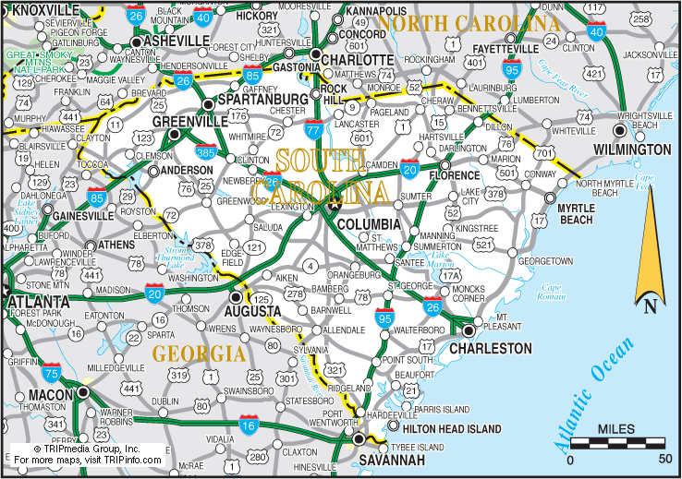
Reference Point
You might describe a position of an object or person based off another object, place or person
Reference Point: a location to which you compare other locations
Example: Charleston, SC is 209 miles southeast from Charlotte, NC

Slide 12
Relative Motion
One way to describe motion involves relative motion

Slide 13
When you give a time instead of a distance,
you are basing your time estimate
on the distance to the football field
and
the person’s speed
Speed: a measure of how fast something moves or the distance it moves, in a given amount of time

Slide 14
Speed, Distance, Time Formulas you can calculate speed, distance, or time using the same diagram Speed= distance/time (Velocity= Distance/time) velocity is speed in a certain direction

Slide 15
Calculating Speed Given Distance & Time
Divide Distance by Time
Distance ÷ Time = Speed
Speed = Distance ÷ Time

Slide 16
Calculating Distance Given Speed & Time
Multiply Speed and Time
Distance = Speed X Time
Speed X Time = Distance

Slide 17
Calculating Time Given Distance and Speed
Divide Distance by Time
Distance ÷ Speed = Time
Time = Distance ÷ Speed

Slide 18
Practice
If a car travels 400 meters in 20 seconds how fast is it going?
2. You arrive in my class 45 seconds after leaving math class which is 90 meters away. How fast did you travel?

Slide 19
So..Velocity
Velocity: speed in a specific direction
Example:
your velocity could be that you are walking east at a speed of 2 meters/second
A person walking NORTH with a speed of 2 meters/sec has the same speed as you do, but NOT the same velocity (they’re going in a different direction)

Slide 20
Acceleration
You can find out how MUCH the tennis ball’s position changed during a certain amount of time if we knew the velocity
We can also measure how the tennis ball’s velocity changed over time
What does ACCELERATION mean in everyday life?

Slide 21
Acceleration
Acceleration: The rate at which velocity changes with time (change in speed and/or direction)
Velocity/Time
(In physics, it’s ANY change in velocity)
Example: car slowing down = accelerating because it’s changing its speed and/or direction
Or.. A runner turning a corner accelerates because the direction of her velocity is changing as she turns

Slide 22
Acceleration Formula
acceleration = (final velocity – original velocity)
time
But when you find acceleration, it’s written like:
Acceleration= 2 km/sec/sec

Slide 23
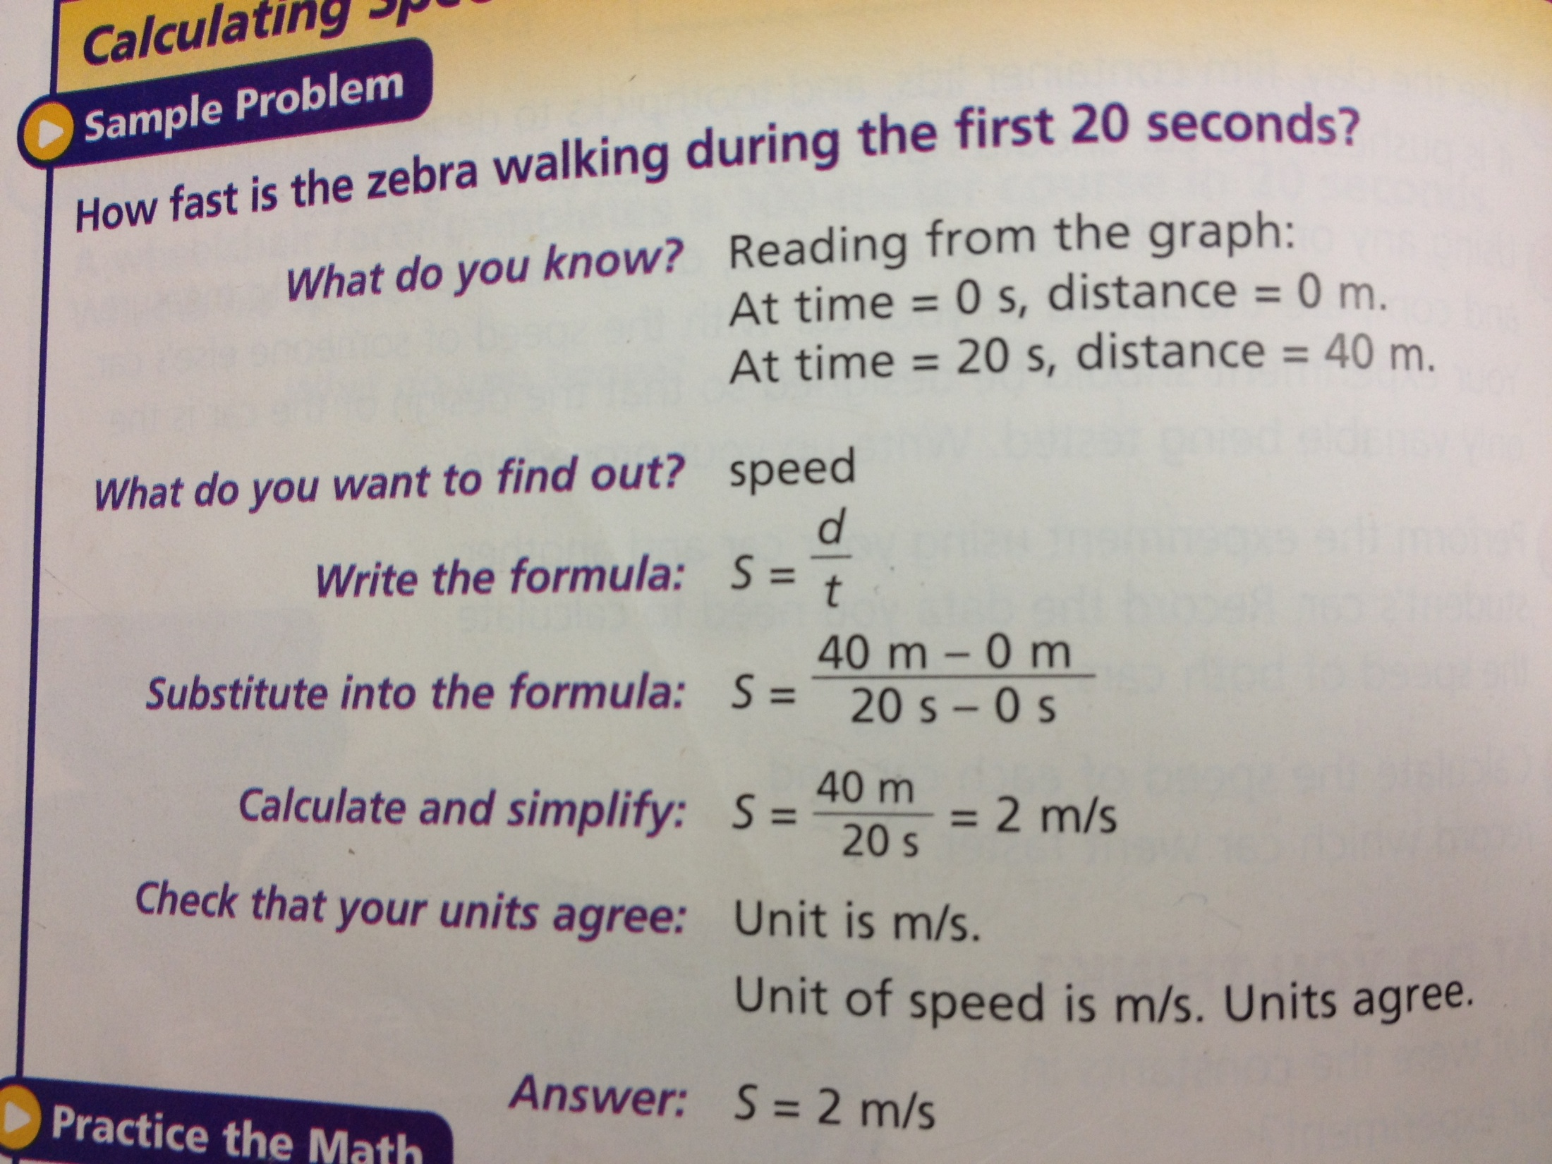

Slide 24
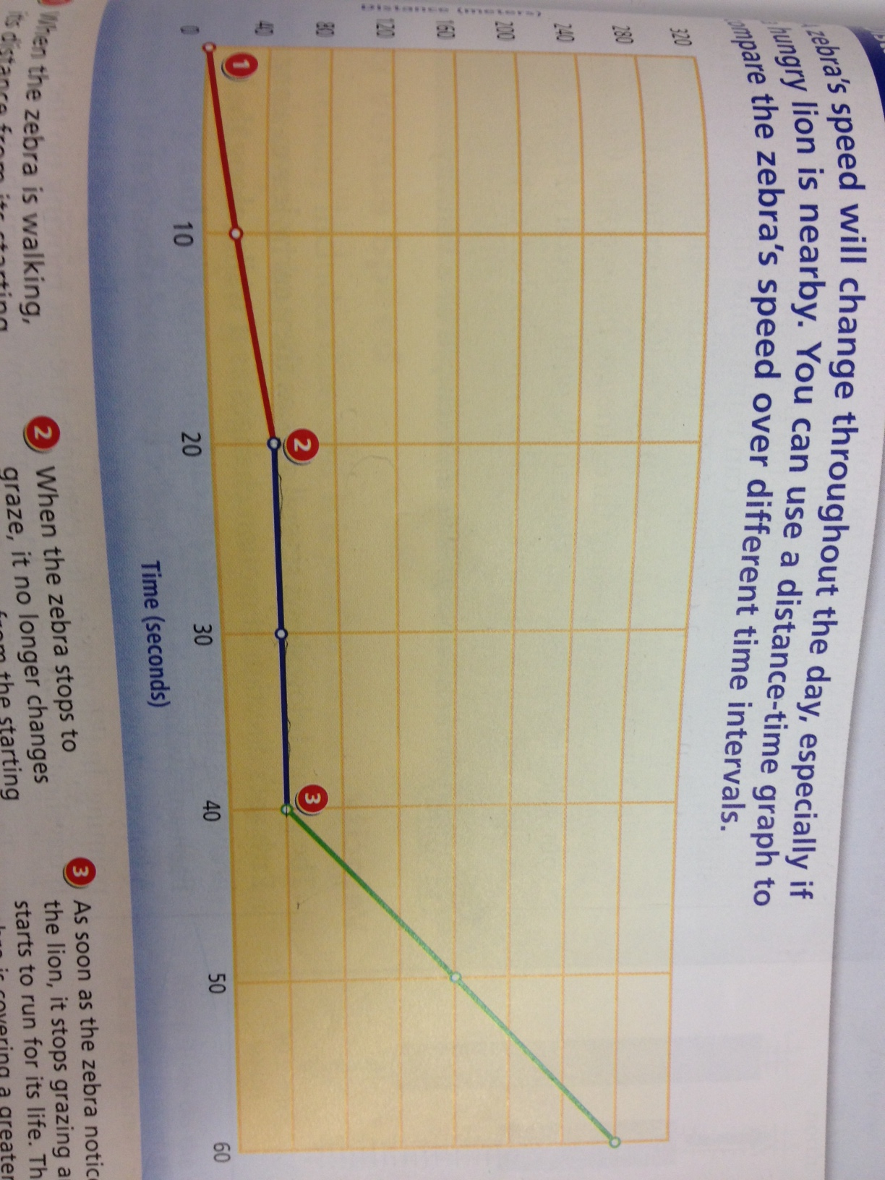

Slide 25
Basic Physics
Force: a push or a pull
Turn to page D 41
What forces are acting on the skater?
Who can read for each force?

Slide 26
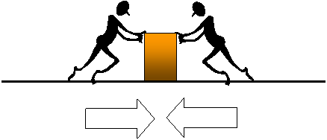
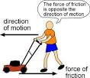
Key Vocab Words
Force: a push or a pull
Friction: the force that resists motion between two surfaces that are pressed together

Slide 27
With the first law of motion…
Inertia: the resistance of an object to a change in speed or direction of its motion
(basically, things that are still want to stay still. Things that are moving want to stay moving)

Slide 28
Newton’s Laws
Newton’s Laws:
1. An object at rests remains at rest, an object in motion remains in motion unless acted upon by an unbalanced force

Slide 29
2. Acceleration of an object increases with more force and decreases with more mass
Force= Mass x Acceleration

Slide 30
3. For every action, there is an equal and opposite reaction

Slide 31
Gravity: the force that objects exert on each other because of their masses

Slide 32
Centers info
Inertia: the resistance of an object to a change in speed or direction of its motion
(basically, things that are still want to stay still. Things that are moving want to stay moving)
1. How did the cup/penny/card experiment and the stack of pennies experiment illustrate inertia?
2. Which of Newton’s Laws talks about inertia?

Slide 33
Two Main Types,..
Turn to page D 122
Kinetic Energy: The energy of motion. Any moving object has some kinetic energy
Potential Energy: stored energy, or the energy an object has because of its position or shape

Slide 34
F=MA
D 51
1kg m/s = 1 Newton
Newtons are units of force (also used to measure momentum)
Let’s do #1
If a 5kg ball is accelerating 1.2 m/s/s, what is the force on it?

Slide 35
Two Main Types,..
Kinetic Energy: The energy of motion. Any moving object has some kinetic energy
Potential Energy: stored energy, or the energy an object has because of its position or shape
Just think.. Does this object have the ability to move?

Slide 37
Mechanical Energy: energy possessed by an object due to its motion or position
* The object’s combined
potential energy and kinetic
energy
* ME= PE + KE
We measure energy in “joules”

Slide 38
Acceleration due to Gravity
Near the surface of Earth, the acceleration due to gravity is 9.8 m/sec/sec
If an object has been in the air for 5 seconds, what is it’s velocity?
Multiply 9.8 x 5= 49.0 m/sec

