Slide 1
Cell Reproduction
Objective:
SWBAT distinguish between the types of cellular reproduction
WARM UP:
1. What is the difference between a dominant and a recessive trait?
Notes:
1

Slide 2
Reviewing Punnett Squares
Who understands this well enough to help others?
Move to tables you can work with (“teachers” and “learners”)

Slide 3
Practice!
Make punnett squares showing the potential offspring of these combinations:
Mother: purebred regular chin (CC)
Father: hybrid regular chin (Cc)
2. Mother: hybrid free earlobes (Ee)
Father: attached earlobes (ee)

Slide 4
Show me the scenarios!
Mother: purebred regular chin (CC)
Father: hybrid regular chin (Cc)

Slide 5
Show me the scenarios!
2. Mother: hybrid free earlobes (Ee)
Father: attached earlobes (ee)

Slide 6
Genes Activity
Physical Trait | Genes
Tongue rolling
Attached Earlobes
Interlocking Fingers
Dimples
Sex/ Gender
Bent Little Finger
Double Jointed Thumb
Freckles
PTC taste
Sodium Benzoate Taste
Widow’s Peak

Slide 7
Genes Activity
Work with your partner at your table
Remember.. DOMINANT traits are uppercase
RECESSIVE traits are lowercase
The reason why you see examples like F- or C- is that they stand for one dominant trait seen but we have no way of knowing if you have TWO dominant traits (purebred) or one recessive trait (hybrid)

Slide 8
Cellular Reproduction
Humans reproduce through sexual reproduction which means the offspring has a combination of genes from both parents
Depending on the organism, reproduction can vary
Both sexual and asexual reproduction involve cell division

Slide 9
Unit C 3.3 Guided Notes
Who can read that first paragraph?
The following definitions are all involving ** ONE Parent**

Slide 10
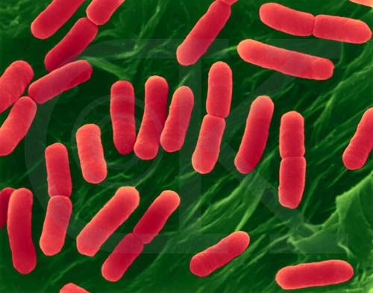
Binary Fission
Is asexual reproduction occurring in _prokaryotes_. The parent organism splits in two, creating two genetically __identical__ cells that are independent of each other.

Slide 11
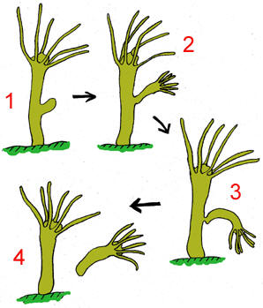
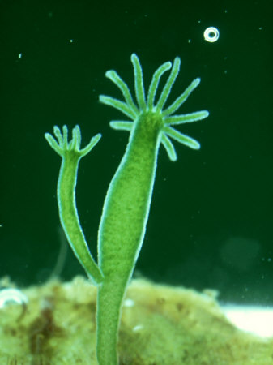
Budding
Is when a parent organism develops a tiny bud on its body. The bud is genetically identical to the _parent__ organism. The _bud_ grows until it gets large enough to break off the parent organism and live independently.
Hydra

Slide 12
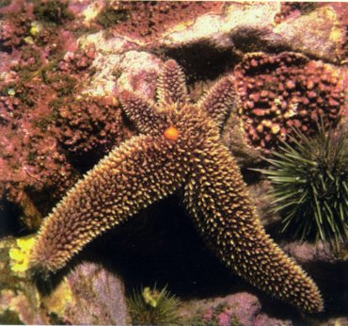
Regeneration
Is when new __tissue__ grows at the site of a wound or lost part and that lost part is replaced. __Starfish__ do this. If a starfish is cut in half, each half can __regenerate__ the part that is lost and eventually becomes a whole starfish. Each half does this and the result is two __genetically__ identical starfish.

Slide 13
Asexual Reproduction
Cell division
One ___parent__ organism
Quick reproduction time
*__Genetically__ identical to parent

Slide 14
Sexual Reproduction
Cell division plus other processes
__Two__ parent organisms
_Slower_reproduction time
*offspring have genetic info combined from ___two__parents

Slide 15
1st and 4th block A Day
Bill Nye Genetics Video
Answer all questions on handout

