Slide 1
Punnett Squares
Objective:
SWBAT explain how to create and complete Punnett Squares
WARM UP:
Copy the title and objective
The warm up question is on the next slide…
Notes:
1

Slide 2
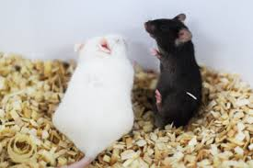
Baby Mice
Sally’s pet mouse had babies. Five of the babies were black and two were white. The father mouse was black and the mother mouse was white. She and her friends wondered why the baby mice were different colors…

Slide 3
Jerome: Baby mice inherit more traits from their father than from their mother
Alexa: The baby mice got half their traits from their father and half from their mother
Devonta: Male traits are stronger than female traits
Anthony: Parent’s traits like fur color don’t matter- nature decides what something will look like
Leslie: Blood type determines what traits babies will have

Slide 4
Genes
GENES are on chromosome pairs
They “code” for a certain trait
Have you ever been told you look like your mother? Your father? Your sister? Your brother?

Slide 5
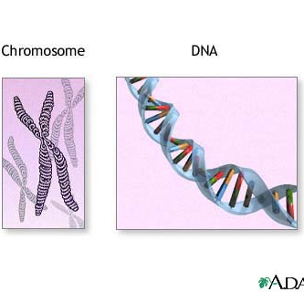
Anatomy of a Chromosome
Humans have 46 chromosomes.
There are a total of 23 pairs of chromosomes or 46 total chromosomes.
Chromosomes are made up of long strands of DNA which contain all the body’s genes.

Slide 6
Nucleus
Genes
Chromatids
DNA strand wrapped around proteins
Chromosomes
Centromere

Slide 7
Vocab Recap!
Alleles- various forms of the same gene
Example: B (brown eyes) b (blue eyes)
Some alleles are “dominant” meaning if they’re present in the gene, then it’s expressed in the phenotype (seen as a trait in a person) BB, Bb
Some alleles are “recessive” meaning it’s only in the phenotype if there are two copies of those alleles example: bb, Bb

Slide 8
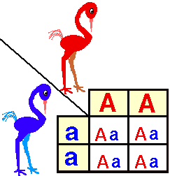
Gregor Mendel noticed that traits are inherited in patterns
A Punnett Square illustrates how parents’ alleles might combine in their offspring (kids)
Mendel and the Peas

Slide 9
C 111

Slide 10
Punnett Square
Creating a Punnett Square
Brown eyes (B) Blue eyes (b)
A mother with brown eyes (Bb) and a father with pure blue eyes (bb)
Father
Mother

Slide 11
Dominant Genes | Recessive Genes
Brown eyes (B) | Blue Eyes (b)
Brown hair (B) | Blonde Hair (b)
Can Roll Tongue (R) | Can’t Roll Tongue (r)
Regular Chin (C) | Cleft Chin (c)
Free Earlobes (E) | Attached Earlobes (e)

Slide 12
Practice!
Use the descriptions to determine what GENOTYPES would be possible for their children
Remember.. Dominant genes are CAPITAL, recessive genes are lower case
HYBRID Example: Bb, Rr, Ee, and so on…
PURE Example: BB, bb, RR, rr, EE, ee

Slide 13
Family 1: Let’s do this together
A mother with pure brown hair and a father with hybrid brown hair
What would be the alleles for the mother? For the father?
Do the rest in your notebook

