Slide 1
Mitosis and Genetics
Objective:
SWBAT explain mitosis and be introduced to genetics vocabulary
WARM UP:
Explain the difference between coarse adjustment and fine adjustment
Notes:
1

Slide 2
About that foldable…
Showed the stages of a process called mitosis
Cells have a life cycle, like we have a life cycle
Cell Cycle: normal sequence of development and division of a cell

Slide 3
Cell Cycle
There are 2 main “phases”of the cell cycle… INTERPHASE: where the cell is just carrying out it’s life
….Then when the cell divides, it’s called MITOSIS and ends with CYTOKINESIS
Mitosis: part of the cell cycle during which the nucleus divides

Slide 4
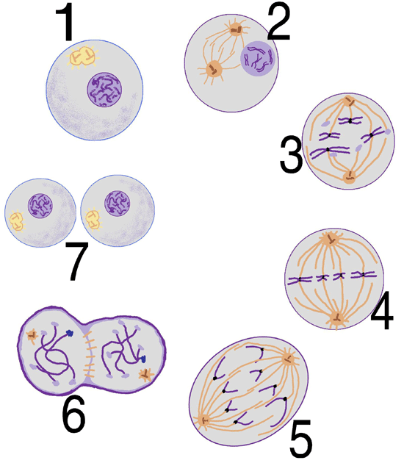
Interphase
Prophase
http://www.cellsalive.com/mitosis.htm
Prometaphase (you don’t have you know this)
Cytokinesis
Metaphase
Telophase
Anaphase

Slide 5
Why Do We Need to Know about Cell Division?
MITOSIS is the process that your cells use to reproduce (make new cells)
This produces two genetically identical “daughter” cells (with exactly the same DNA)
DNA that is wrapped around protein forms CHROMOSOMES…and this begins our study of genetics

Slide 6
Vocabulary Strategies
There are MANY MANY new vocab words in the genetics unit
Most of the words will be new to you
You will use vocabulary strategies on pages R50-R51 to learn these words

Slide 7
You and your partner have an index card with a term on one side and a vocab strategy on the other side
Don’t know your vocabulary strategy? Pages R50-R51 will tell you how!
BUT you have to research the term using your textbook to create an informative graphic organizer
Draw a rough draft in your notebook and have me check it

Slide 8
Vocab Words
1. Hybrid
2. Purebred
3. Dominant
4. Recessive
5. Allele
6. Gene
7. Genotype
8. Phenotype
9. Chromosomes
10. Heredity
11. Punnett square
12. Probability
13. Gregor Mendel
14. Gametes
15. meiosis

Slide 9
“Final” draft
Using a clean white paper (that I will give you), re-draw your vocab strategy
Place all papers around the room along the counters
Take a “Strategy Walk” with your notebook and COPY out the word and definition

Slide 10
Bill Nye: Genetics
http://www.youtube.com/watch?v=OZIQTMHmWmg
WATCH and LISTEN to the video
Try to identify the definitions of the new genetics words

