Slide 1
Energy
Objective:
SWBAT demonstrate understanding of potential and kinetic energy
Warm Up:
What is the difference between potential and kinetic energy?
Use your foldable: what is the formula in the 2nd law of motion?
Notes:
1

Slide 2
Review…
What is a FORCE?
Who remembers how to calculate FORCE?

Slide 3
F=MA
FORCE is measured in “newtons”
1kg x m/s/s = 1 Newton
Newtons are units of force (also used to measure momentum)
Unit for mass
Unit for acceleration

Slide 4
Quick Practice
Calculating FORCE
How much FORCE does it take to push a 5kg ball to an acceleration of 1.2 m/s/s ?
Write your answer in NEWTONS
(We will practice this next class)

Slide 5
FORCES and ENERGY
Review from last class…
Kinetic Energy: The energy of motion. Any moving object has some kinetic energy
Potential Energy: stored energy, or the energy an object has because of its position or shape

Slide 6
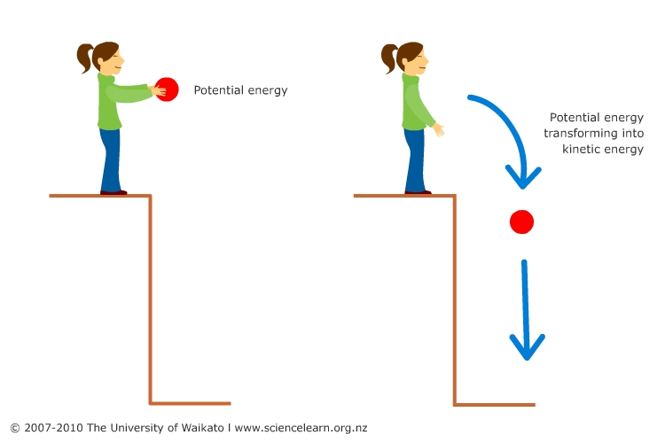

Slide 7
Mechanical Energy: energy possessed by an object due to its motion or position
* The object’s combined
potential energy and kinetic
energy
* ME= PE + KE
We measure force in “newtons” and we measure energy in “joules”

Slide 8
Energy in Action
Challenge
Use the materials and tools to construct a balloon-powered vehicle (similar to the one pictured on the paper) that will travel the greatest distance

Slide 9
For 5 minutes…
Design (draw out) how you will build your car
Make sure EVERYONE in your group agrees to the design (use your knowledge of forces to build the car that goes the farthest!)

Slide 10
For 20 minutes..
2. Build it
Make sure EVERYONE in your group gets to help with the construction
(do not lose the pieces to your car)

Slide 11
Test Drive
Choose only 1 person to be the one who blows up the balloon
At the end of today, you will clean the mouthpiece with an alcohol swab (so you won’t spread germs to my next class!)
Tests

Slide 12
Write Time
How was your car’s design different from the winning car’s design?
What can you say about friction in these examples?

