Slide 1
Microscopes and Cells Review
Objective:
SWBAT prepare for upcoming test by reviewing microscopes and cells
WARM UP:
Which protist uses pseudopods to feed and move?
Are volvox plant-like or animal-like protists?
Notes:
1

Slide 2
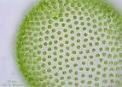
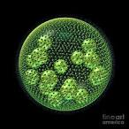
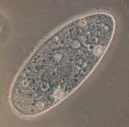
4 Types (but there are many more)
Volvox: http://www.youtube.com/watch?v=9pjW1cMfTz8
Paramecium:
http://www.youtube.com/watch?v=saLYHUs6cWk
Amoeba:
http://www.youtube.com/watch?v=aWItglvTiLc&feature=related
Euglena:
http://www.youtube.com/watch?v=J3sgoy22Ij4

Slide 3
Protist | Type of Organism | Movement (How does it move?) | Illustration (What does it look like?) | Extra Facts
Volvox | unicellular | flagella |  | Chloroplasts Photosynthesis 2. colonies
Paramecium | unicellular | Cilia |  | Ponds Streams 2. Contractile vacuole
Amoeba | unicellular | Pseudopods (false foot) |  | Extension feeding
Euglena | unicellular | flagella |  | Photosynthesis Chloroplasts 2. eyespot

Slide 4
Test Review
Microscopes note cards quizzing
Protist Game
Cell Organelle online simulation
Microviewers of cell organelles
Ipad websites review
…and several more

Slide 5
Work on the Study Guide
Finish filling out your study guide

