Slide 1
Newton’s Laws
Objective:
SWBAT explore Newton’s Laws by completing stations
Warm Up:
1. What do you remember about Newton’s Laws from 6th grade?
Notes:
1

Slide 2
Homework Review
Any questions?

Slide 3
Basic Physics
Force: a push or a pull
Turn to page D 41
What forces are acting on the skater?
Who can read for each force?

Slide 4
So… What forces are acting on YOU… RIGHT NOW??
These forces can be explained with NEWTON’s LAWS OF MOTION
However, you first need some notes…

Slide 5
Foldable
Tri fold
Follow my directions

Slide 6
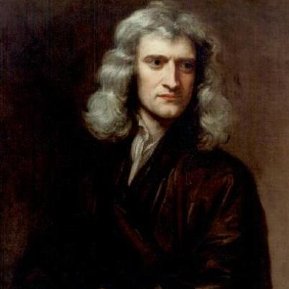
First Law of Motion
1. An object at rests remains at rest, an object in motion remains in motion unless acted upon by an unbalanced force

Slide 7
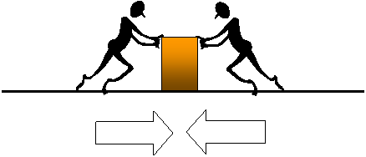
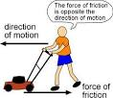
Key Vocab Words
Force: a push or a pull
Friction: the force that resists motion between two surfaces that are pressed together

Slide 8
With the first law of motion…
Inertia: the resistance of an object to a change in speed or direction of its motion
(basically, things that are still want to stay still. Things that are moving want to stay moving)

Slide 9
Second Law of Motion
2. Acceleration of an object increases with more force and decreases with more mass
Force= Mass x Acceleration

Slide 10
Third Law of Motion
3. For every action, there is an equal and opposite reaction

Slide 11
Centers
Centers are passed to each table(you are not getting up from your table, the box is passed to you)
Fill out the back of your foldable with answers from each center
Each center illustrates one or more of Newton’s Laws or forces related to his laws

Slide 12
Centers info
Exploring Projectiles: Pencil Toss
1. How did this illustrate gravity?
2. What did you notice about the pencils and the rate at which they dropped?

Slide 13
Gravity: the force that objects exert on each other because of their masses

Slide 14
Centers Info
Center of Gravity:
What did you find out?
You must keep your center of mass directly above the supporting foot to remain in balance

Slide 15
Centers info
Remember your definition of “Inertia”: the resistance of an object to a change in speed or direction of its motion
(basically, things that are still want to stay still. Things that are moving want to stay moving)
1. How did the cup/penny/card experiment and the stack of pennies experiment illustrate inertia?
2. Which of Newton’s Laws talks about inertia?

Slide 16
Centers Info
Hammer Toss
How did the hammer land most of the time?
What does this tell you about gravity and weight?

Slide 17
A heavier object will have a larger gravitational force acting upon it (proportional to its mass), but its inertia will also make it harder to accelerate (again proportional to its mass), and these two things exactly cancel out.

Slide 18
Centers Info
Marble Roll (Action/Reaction)
What did you notice?
Which law does this illustrate?
the physics of newton's cradle

Slide 19
Exit Ticket
It’s important to always wear your seatbelt! A person who is in a car accident is sometimes thrown from the car during a collision.
This is an example of which of Newton’s laws in action? How do you know?

