Slide 1
Seating Charts
1st Row: Jovani, Courtney, Christina, Shaleek, Joi, Gabriel
2nd Row: Tatiana, Andrea, Angel H, Elijah, James J, Eamon K
3rd Row: Nyghee, Desmond, Cameron, James P, Sophie
4th Row: Angel S, Yeadon, Hannah, Keyahja, Aisha, Bethlehem

Slide 2
Seating Charts
1st Row: John, Drew, Ty, Allan, Nancy, Laura, JNeaya
2nd Row: Sarah, Brandon, Angel, Gracie, Edgardo, Ariana, Lee
3rd Row: Shehaan, Amanda, Elizabeth, Mya, Fabiana, Sean, Marissa
4th Row:Bradley, Victoria, Frank, Mimi, Anna, Nigel

Slide 3
Seating Charts
1st Row: Terry, Yorleny, Nikki, Lilly, Chris, Alex, David, Rachel
2nd Row: Michael, Wyatt, Allie, Lizzie, Jean Carlos, Megan, Adolfo
3rd Row: Jenise, Ainsley, Nielser, Kensi, Louise, Mason, Lauren, Zaria
4th Row: Emma, Brooke, Jennifer, Sam, Tilly, Jeffrey, Anna, Aaron

Slide 4
Cells and Genetics Review
Objective:
SWBAT review genetics concepts in preparation for the NC Common Exam
WARM UP:
Name 2 differences between plant and animal cells
What is heredity?
Notes:
4

Slide 5
Extra Extra!
Extra CREDIT
Find a current event article about one of the topics we discussed this year (human body, cells and genetics, atmosphere and weather, or forces and motion)
Print out article
Write a ½ page summary (single spaced) of the article and how it relates to the topic (human body, cells and genetics, atmosphere and weather, or forces and motion)

Slide 6
DUE MAY 30
LATE WORK
WILL NOT BE ACCEPTED AFTER THIS DATE

Slide 7
Several Ways to Review today…
Flocabulary “Cell Rap”
Spongebob Genetics worksheet (practicing Punnett Squares)
Genetics Vocabulary walk in the hallway (only 5 people at a time)
Crossword puzzle to complete

Slide 8
Cell Rap
LISTEN to the song
http://www.flocabulary.com/cells-and-body-systems/
READ the words
FILL OUT the missing information

Slide 9
Physics Test Corrections
Same thing we did for genetics test corrections
Due by the end of this class (but shouldn’t take you that long)
If you don’t need to do corrections, put your test in your notebook

Slide 10
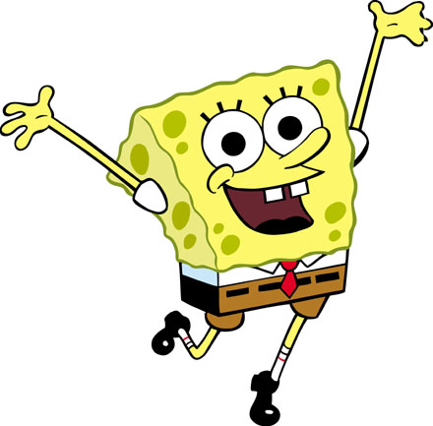
SpongeBob Genetics
Use your notebook, textbook, or knowledge in your head!
Complete the worksheet with your partner

Slide 11
Scientists at Bikini Bottoms have been investigating the genetic makeup of the organisms in this community.
Use the information provided and your knowledge of genetics to answer each question.
For each genotype below, indicate whether it is a heterozygous (He) OR homozygous (Ho).
TT _____ Bb _____ DD _____ Ff _____ tt _____ dd _____
Dd _____ ff _____ Tt _____ bb _____ BB _____ FF _____
Which of the genotypes in #1 would be considered purebred?
Which of the genotypes in #1 would be hybrids?

Slide 12
Scientists at Bikini Bottoms have been investigating the genetic makeup of the organisms in this community.
Use the information provided and your knowledge of genetics to answer each question.
For each genotype below, indicate whether it is a heterozygous (He) OR homozygous (Ho).
TT Ho Bb He DD Ho Ff He tt Ho dd Ho
Dd He ff Ho Tt He bb Ho BB Ho FF Ho
Which of the genotypes in #1 would be considered purebred?
TT Ho DD Ho tt Ho dd Ho ff Ho bb Ho BB Ho FF Ho
Which of the genotypes in #1 would be hybrids?
Bb He Ff He Dd He Tt He

Slide 13
2. Determine the phenotype for each genotype using the information provided about SpongeBob.
Yellow body color is dominant to blue.
YY ________________ Yy ________________ yy ________________
Square shape is dominant to round.
SS ________________ Ss ________________ ss ________________

Slide 14
2. Determine the phenotype for each genotype using the information provided about SpongeBob.
Yellow body color is dominant to blue.
YY - Yellow Yy - Yellow yy - blue
Square shape is dominant to round.
SS –square Ss – square ss - round

Slide 15
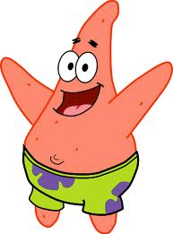
3. For each phenotype, give the genotypes that are possible for Patrick.
A tall head (T) is dominant to short (t).
Tall = _______________ Short = _______________
Pink body color (P) is dominant to yellow (p).
Pink body = _____________ Yellow body = _________________

Slide 16
3. For each phenotype, give the genotypes that are possible for Patrick.
A tall head (T) is dominant to short (t).
Tall = TT, or Tt Short = tt
Pink body color (P) is dominant to yellow (p).
Pink body = PP, or Pp Yellow body = pp

Slide 17
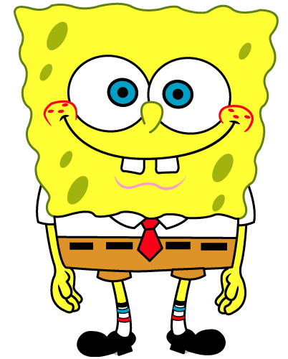
4. SpongeBob SquarePants recently met SpongeSusie Roundpants at a dance. SpongeBob is heterozygous for his square shape, but SpongeSusie is round. Create a Punnett square to show the possibilities that would result if SpongeBob and SpongeSusie had children.
HINT: Read question #2!
List the possible genotypes and phenotypes for their children.
B. What are the chances of a child with a square shape? ____ out of ____ or ____%
C. What are the chances of a child with a round shape? ____ out of ____ or ____%

Slide 18
4. SpongeBob SquarePants recently met SpongeSusie Roundpants at a dance. SpongeBob is heterozygous for his square shape, but SpongeSusie is round. Create a Punnett square to show the possibilities that would result if SpongeBob and SpongeSusie had children.
HINT: Read question #2!
List the possible genotypes and phenotypes for their children. Ss or ss, square, round
B. What are the chances of a child with a square shape? 2 out of 4 or 50 %
C. What are the chances of a child with a round shape? 2 out of 4 or 50 %
SpongeBob
 | S | s
s | Ss | ss
s | Ss | ss
SpongeSusie

Slide 19
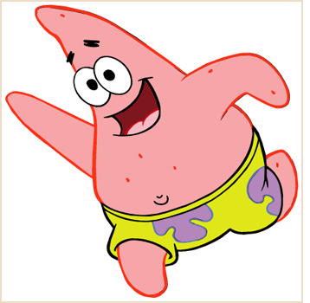
5. Patrick met Patti at the dance. Both of them are heterozygous for their pink body color, which is dominant over a yellow body color. Create a Punnett square to show the possibilities that would result if Patrick and Patti had children. HINT: Read question #3!
List the possible genotypes and phenotypes for their children.
B. What are the chances of a child with a pink body? ____ out of ____ or ____%
C. What are the chances of a child with a yellow body? ____ out of ____ or ____%

Slide 20
5. Patrick met Patti at the dance. Both of them are heterozygous for their pink body color, which is dominant over a yellow body color. Create a Punnett square to show the possibilities that would result if Patrick and Patti had children. HINT: Read question #3!
List the possible genotypes and phenotypes for their children. PP, Pp, pp, pink, yellow
B. What are the chances of a child with a pink body? 3 out of 4 or 75 %
C. What are the chances of a child with a yellow body? 1 out of 4 or 25 %
Patrick
 | P | p
P | PP | Pp
p | Pp | pp
Patti

Slide 21
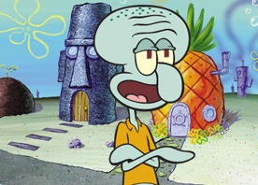
6. Everyone in Squidward’s family has light blue skin, which is the dominant trait for body color in his hometown of Squid Valley. His family brags that they are a “purebred” line. He recently married a nice girl who has light green skin, which is a recessive trait. Create a Punnett square to show the possibilities that would result if Squidward and his new bride had children. Use B to represent the dominant gene and b to represent the recessive gene.
List the possible genotypes and phenotypes for their children.
B. What are the chances of a child with light blue skin? ____%
C. What are the chances of a child with light green skin? ____%
D. Would Squidward’s children still be considered purebreds? Explain!

Slide 22
6. Everyone in Squidward’s family has light blue skin, which is the dominant trait for body color in his hometown of Squid Valley. His family brags that they are a “purebred” line. He recently married a nice girl who has light green skin, which is a recessive trait. Create a Punnett square to show the possibilities that would result if Squidward and his new bride had children. Use B to represent the dominant gene and b to represent the recessive gene.
List the possible genotypes and phenotypes for their children. Bb, blue
B. What are the chances of a child with light blue skin? 100%
C. What are the chances of a child with light green skin? 0%
D. Would Squidward’s children still be considered purebreds? Explain! No, hybrids
Squidward
 | B | B
b | Bb | Bb
b | Bb | Bb
Nice Girl

Slide 23
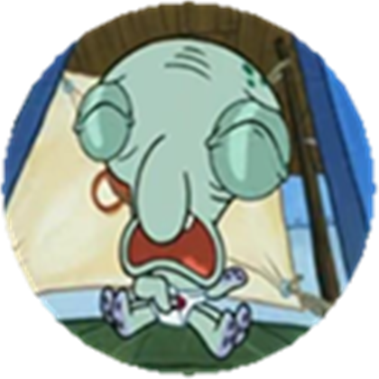
7. Assume that one of Squidward’s sons, who is heterozygous for the light blue body color, married a girl that was also heterozygous. Create a Punnett square to show the possibilities that would result if they had children.
List the possible genotypes and phenotypes for their children.
B. What are the chances of a child with light blue skin? ____%
C. What are the chances of a child with light green skin? ____%

Slide 24
7. Assume that one of Squidward’s sons, who is heterozygous for the light blue body color, married a girl that was also heterozygous. Create a Punnett square to show the possibilities that would result if they had children.
List the possible genotypes and phenotypes for their children. BB, Bb, bb, blue, green
B. What are the chances of a child with light blue skin? 75%
C. What are the chances of a child with light green skin? 25%
Squidward’s son
 | B | b
B | BB | Bb
b | Bb | bb
Nice girl

Slide 25
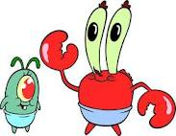
8. Mr. Krabbs and his wife recently had a Lil’ Krabby, but it has not been a happy occasion for them. Mrs. Krabbs has been upset since she first saw her new baby who had short eyeballs. She claims that the hospital goofed and mixed up her baby with someone else’s baby. Mr. Krabbs is homozygous for his tall eyeballs, while his wife is heterozygous for her tall eyeballs. Some members of her family have short eyes, which is the recessive trait. Create a Punnett square using T for the dominant gene and t for the recessive one.
List the possible genotypes and phenotypes for their children.
B. Did the hospital make a mistake? Explain your answer.

Slide 26
8. Mr. Krabbs and his wife recently had a Lil’ Krabby, but it has not been a happy occasion for them. Mrs. Krabbs has been upset since she first saw her new baby who had short eyeballs. She claims that the hospital goofed and mixed up her baby with someone else’s baby. Mr. Krabbs is homozygous for his tall eyeballs, while his wife is heterozygous for her tall eyeballs. Some members of her family have short eyes, which is the recessive trait. Create a Punnett square using T for the dominant gene and t for the recessive one.
List the possible genotypes and phenotypes for their children. TT or Tt
B. Did the hospital make a mistake? Explain your answer. Yes, they can’t have short eyeballed children
Mr. Krabbs
 | T | T
T | TT | TT
t | Tt | Tt
Mrs. Krabbs

