Slide 1
Momentum and Walking Lab
Objective:
SWBAT complete speed and acceleration labs and understand momentum
Warm Up:
Turn to page D20-D21 in your textbook
Read the sample problem on D20 and look at the graph on D21
Using the graph, what is the speed of the zebra between
the 40s-60s time interval?
Notes:
1

Slide 2
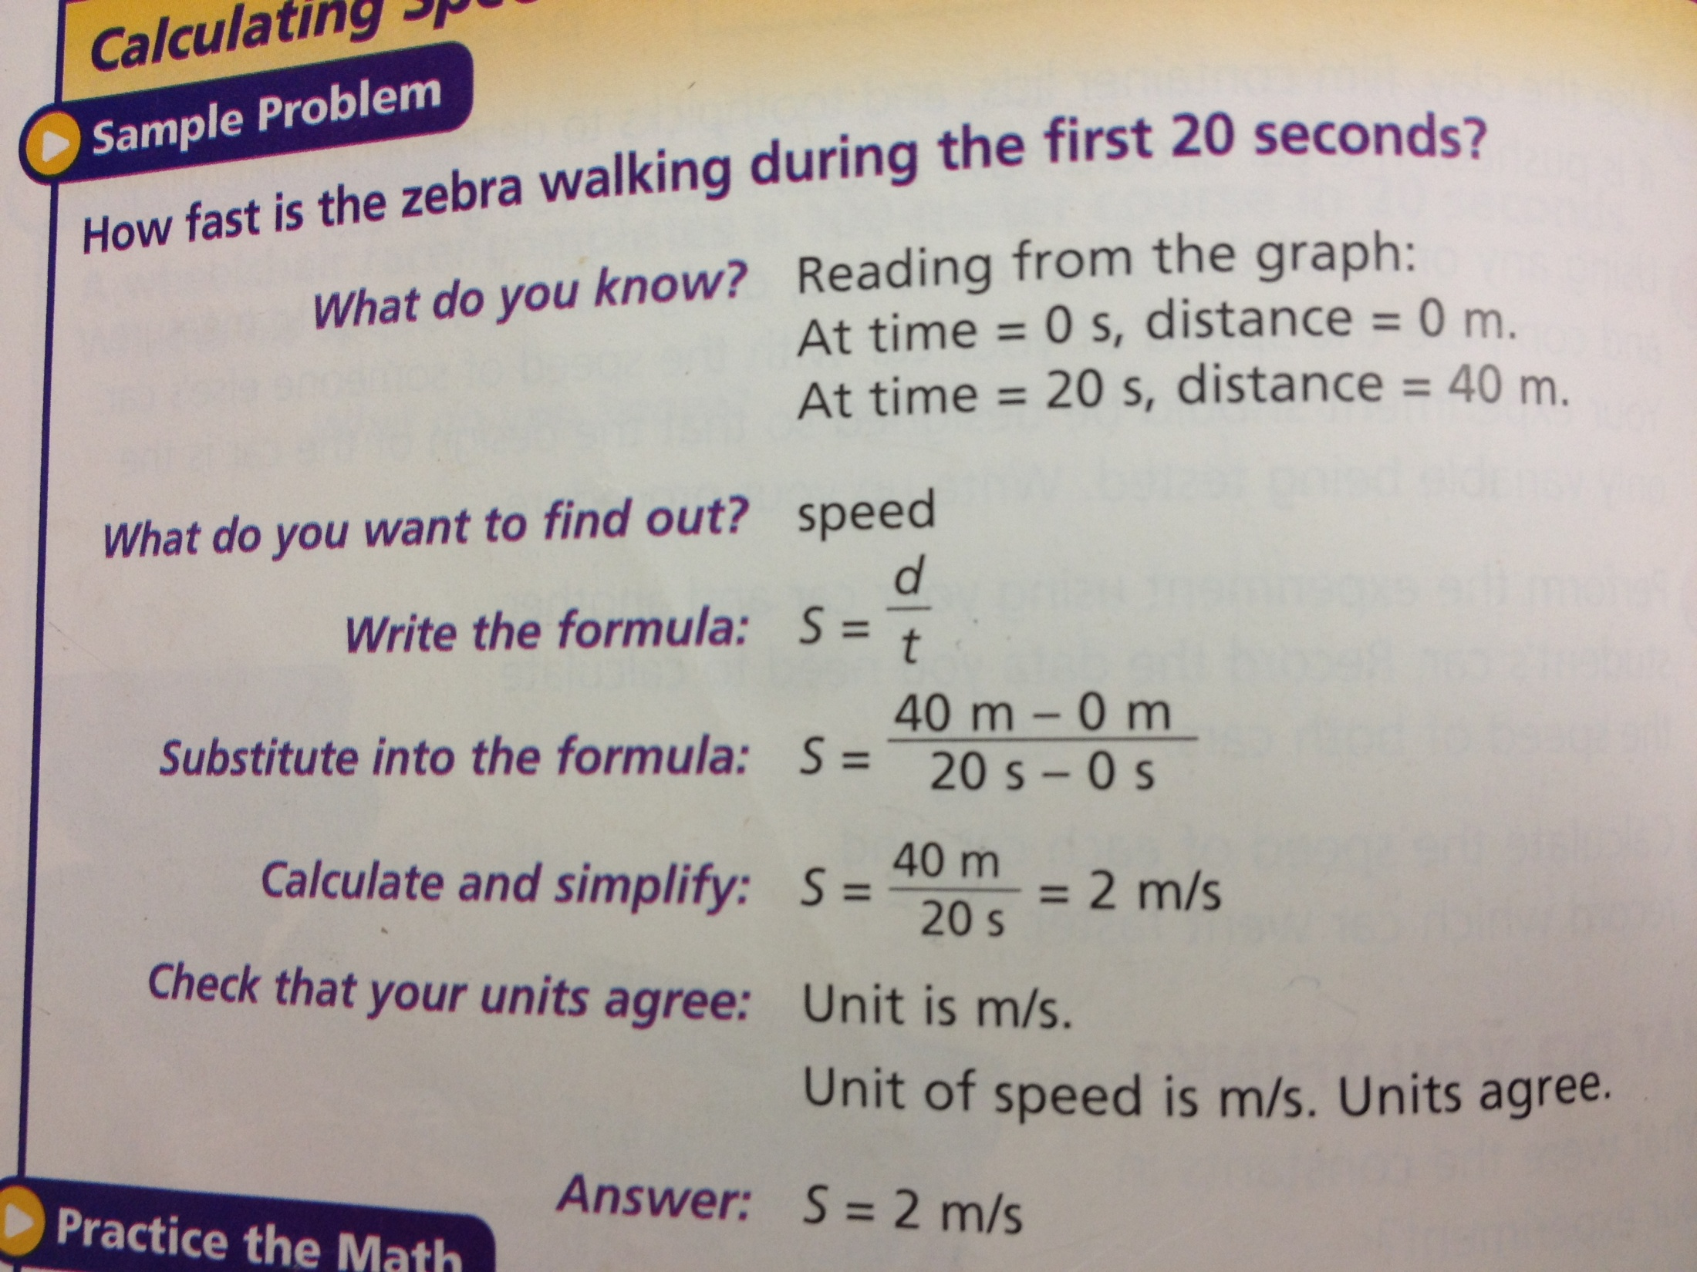

Slide 3
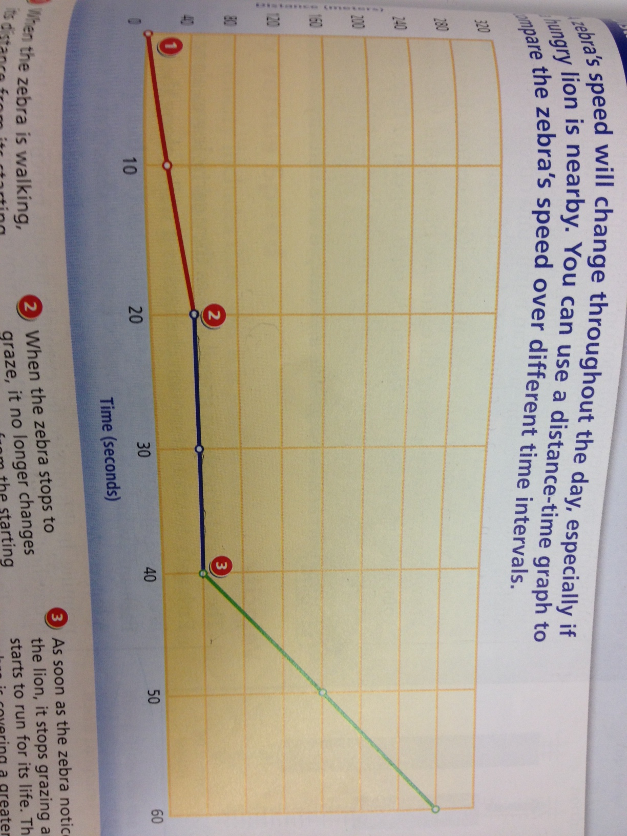

Slide 4
Forces of Motion: Momentum
How would you describe it?

Slide 5
Momentum -> a measure of mass in motion
-> Momentum= mass x velocity
p = mv
-> The momentum of an object
depends on its mass
Look at D 65

Slide 6
Using our new formula…
Momentum= Mass x Velocity
P = mv

Slide 7
Momentum questions
OBJECT | MASS (kg) | VELOCITY (m/s) | MOMENTUM Kg x m/sec
bullet | 0.004 | 600
frog | 0.9 | 12
meteorite | 0.1 | 1,000
baseball | 0.14 | 30
Rocket | 36,000 | 1,800
Satellite | 3,000 | 8,000

Slide 8
The Walking Lab and Acceleration Lab
Going outside
We need to review what acceleration IS and how to calculate acceleration, velocity, and speed…

Slide 9
Review: Acceleration
Acceleration: The rate at which velocity changes with time (change in speed and/or direction)
Velocity/Time
(In physics, it’s ANY change in velocity)
Example: car slowing down = accelerating because it’s changing its speed and/or direction
Or.. A runner turning a corner accelerates because the direction of her velocity is changing as she turns

Slide 10
Review: Acceleration Formula
acceleration = (final velocity - original velocity)
time
But when you find acceleration, it’s written like:
Acceleration= 2 km/sec/sec
Because it’s Velocity (which is d/t)/ Time

Slide 11
Lab 1: Walking Lab
Groups of 3
Three cones
Person 1: timer
Person 2: walker
Person 3: data keeper
Switch roles after each person walks

Slide 12
Lab 2: Acceleration
Using the accelerometers
Make sure you’re pointing the card in the direction of the arrow
Follow all directions and answer ALL questions!

Slide 13
Whenever you are waiting for a station, work on the back of your paper
Calculators will be outside, but please bring your own if you have it
Bring your notebook, too!

Slide 14
Good expectations for the lab?
What about walking down the hall?
Consequences

