Slide 1
Body Systems Review
Objective:
SWBAT review the human body systems in preparation for the NC Common Exam
WARM UP:
List the body systems we covered in 7th grade science
Which system is made up of the brain and spinal cord?
Notes:
1

Slide 2
Human Body Systems Review pt 1
Due TODAY
Let’s go over it

Slide 3
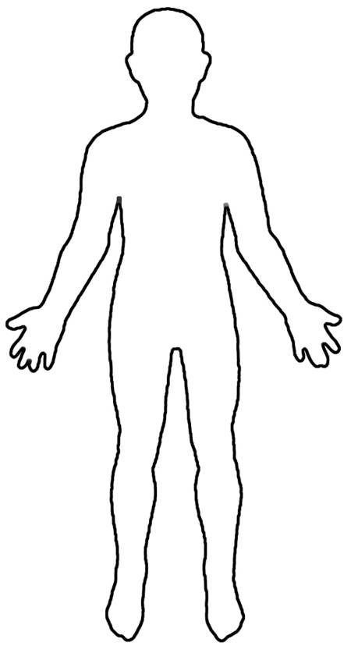
Body Drawings!
With your partner, DRAW as many organs and structures of the body that you can remember. Then check your drawing with the diagrams in the book in Chapter B. How’d you do?
Compare your drawing with another group’s drawing

Slide 4
Review
Move through stations to review the body
Body books
Organ models (2)
3 (different) Computer stations
iPad app station
Work on Human Body Pt. 2 review sheet while waiting for a station

Slide 5
Last 30 min of class… Video Quiz
Part 1
Part 2

Slide 6
Review- Covering the digestive, nervous, excretory, and endocrine systems
LISTEN and READ the definition
TALK to your group about which organ or body system is being defined
WAIT until I call TIME (10 seconds later)
HOLD up the correct word

Slide 7
Absorbs useable food substances which are sent to all body parts by blood vessels. Food digestion is now complete

Slide 8
The main structures in the endocrine system and are made of groups of specialized cells.. They are sent through the blood to produce an effect in target cells

Slide 9
Produces digestive juices to further break down food in digestion

Slide 10
Produces digestive juice called bile

Slide 11
Food passageway between mouth and stomach

Slide 12
This body system controls the conditions in your body by making and releasing chemicals called hormones

Slide 13
Nerve Cells

Slide 14
This body system disposes of liquid waste products removed from the blood

Slide 15
The upper two chambers of the heart

Slide 16
This body system disposes of solid waste from food

Slide 17
A joint that allows for movement

Slide 18
Type of muscle that is involuntary and makes up most organs in the body

Slide 19
Where two bones meet

Slide 20
Type of muscle that makes up the heart

Slide 21
Body system that allows for strength and movement

Slide 22
considered the body’s filters because they filter chemical waste from the blood

Slide 23
Body system that provides structure and support

Slide 24
Receives food, churns it, and adds gastric juices to it

Slide 25
tubes that bring the waste liquid from the kidneys to the bladder

Slide 26
Stores unused solid substances after water is removed

Slide 27
a muscular sac that acts as a storage place for urine

Slide 28
Stores digestive juice called bile

Slide 29
body system that coordinates actions and transmits signals between parts of the body through neurons

Slide 30
sensory and motor nerves that branch off the spinal cord

Slide 31
Consists of the brain and spinal cord

Slide 32
This type of joint allows for full range of motion and can be seen in the shoulder

Slide 33
Answers
Small intestine
Glands
Pancreas
Liver
Esophagus
Endocrine system
Neurons
Excretory system

Slide 34
Answers
9. Atria
10. Digestive system
11.Movable joint
12. Smooth muscle
13. Joint
14. Cardiac muscle
15. Muscular system
16. Kidneys
17. Skeletal system

Slide 35
Answers
18. Stomach
19. Ureters
20. Large intestine
21. Bladder
22. Gallbladder
23. Nervous system
24. Peripheral nervous system
25. Central nervous system
26. Ball and socket joint

