Slide 1
Weather Review
Objective: SWBAT review weather concepts in preparation for NC Common Exam
WARM UP:
Use the weather notes in your notebook OR Chapter A of the textbook:
1. What are the 4 layers of the atmosphere?
2. What are the three types of heat transfer?

Slide 2
Weather Crossword Puzzle
Check it
Any questions?

Slide 3
Team Competitions
We will do some review questions today
You will earn points
The team with the most points = Winners
1. Video Quiz
2. Outdoor Quiz (Is it raining? Then no outdoor quiz ☹ )

Slide 4
Weather Video Quiz
NOT for a class grade
IS a team competition
3 rounds of questions (if we have time)
Write your group’s answer on the markerboard and hold up when I pause the question!

Slide 5
Review Game
6 teams, lined up
Team Lead: sets the “pace”. At the front of the team line
Team Spokesperson: answers the questions after consulting with the group
Each team will get questions and have 10 seconds to answer (sometimes there are BONUS opportunities)
STAY WITH YOUR GROUP at all times!

Slide 6
Weather
Make sure you have all these terms in your notebook. If not, COPY them down
Atmosphere Radiation Ultraviolet Radiation Air Pollution Particulate Smog
Fossil Fuel Infrared Radiation Greenhouse Effect Greenhouse Gas Altitude Ozone
Convection Conduction Density Cycle
Cold/warm/stationary fronts 4 Layers of Atmosphere

Slide 7
Worksheet
Complete the diagrams
Any more questions?

Slide 8
The following slides are pulled from all powerpoints created and given this year as you studied weather/atmosphere

Slide 9
Pie Chart: Gases in Atmosphere

Slide 10
So… How’d you do?

Slide 11
What Do You Remember?
Evaporation: liquid changing into gas
Condensation: gas changing into a liquid
Precipitation: any type of solid or liquid water falling to Earth’s surface
Runoff: precipitation rolling off the ground’s surface
Infiltration: liquid water seeping through the ground
Write it down if you don’t know it!

Slide 12
Layers of the Atmosphere

Slide 13
Foldable
Get out your atmosphere foldable

Slide 14
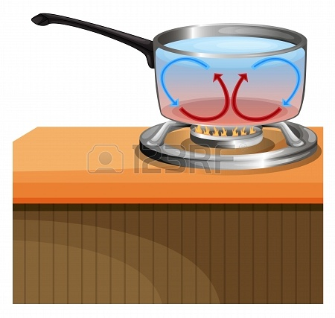
Heat Transfer
Convection: Transfer of energy from place to place by motion of LIQUID or GAS

Slide 15
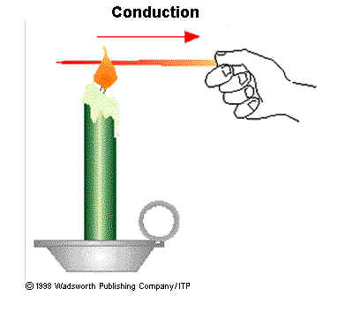
Heat Transfer
Conduction: Transfer of heat energy from one substance to another through DIRECT CONTACT

Slide 16
Heat Transfer
Radiation: energy that travels across distance in certain types of waves

Slide 17
Back to your Drawing…
Using the definitions of energy transfer, LABEL your drawing to show where each occurs!

Slide 18
CONDUCTION
CONVECTION
CONDUCTION
HEAT! HEAT! HEAT!
For radiation, hold your hand close to the top of the hot plate. What do you feel?

Slide 20
Radiation…
What are they? Convection, Conduction, and Radiation
The Earth ABSORBS the sun’s radiation as it heats the ground

Slide 21
What does it mean?
5% solar energy is reflected by Earth’s surface
25% is reflected by clouds and atmosphere
20% absorbed by clouds and atmosphere
50% absorbed by Earth’s surface

Slide 22
Write in your Notebook:
30% of solar energy is reflected
70% of solar energy is absorbed

Slide 23
From the Foldable and Vocab Sheet…
What is Ozone?
Where is it located in the layers of the atmosphere?

Slide 24
Ozone
Ozone: A gas molecule that consists of 3 oxygen atoms
Oxygen molecule
The Ozone Layer is found in the STRATOSPHERE
Ozone Molecule

Slide 25
Video
Answer all questions
We will stop the video every 5 questions and review
This will be some of your NOTES on OZONE so make sure you get the right answers!

Slide 26
What’s the Big Deal?
The layers of the atmosphere can absorb light, reflect light, or let it pass through
Each layer of the atmosphere is made up of different mixtures of gases which are different temperatures
Ozone protects life on Earth by absorbing harmful UV radiation from the sun

Slide 27
Greenhouse Effect
What do you know?

Slide 28
Greenhouse Effect
Helps keep Earth warm
Definitions of Greenhouse gases and Greenhouse Effect?

Slide 29
Greenhouse Effect: The process by which certain gases in a planet’s atmosphere absorb and send out infrared radiation, resulting in increase of surface temperature
Greenhouse Gases: Gases, like carbon dioxide and methane, that absorb and give off infrared radiation

Slide 30
To begin our study of WIND, we have to talk about…
AIR PRESSURE
and
UNEVEN HEATING of the EARTH

Slide 31
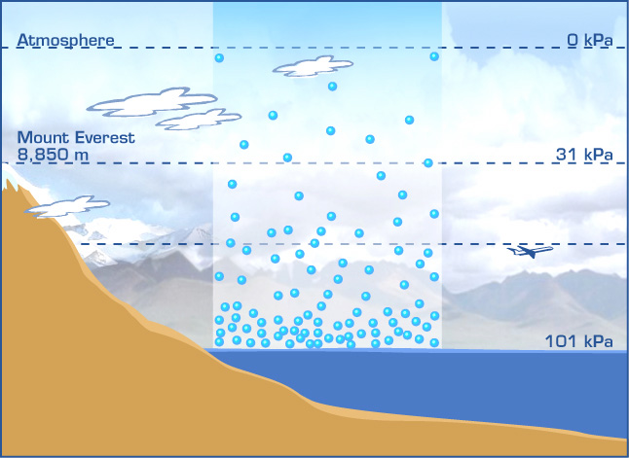
Textbook Section 2.1
What do you remember about density?
Air Pressure: the force of air molecules on an area
Air Pressure and Altitude: pg 44 diagram

Slide 32
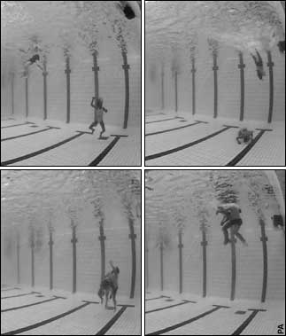
Air pressure and density are HIGHER at a lower altitude
Air pressure and density are LOWER at a higher altitude
Think of it…like you’re at the bottom of a “swimming pool “
full of the atmospheric air

Slide 33
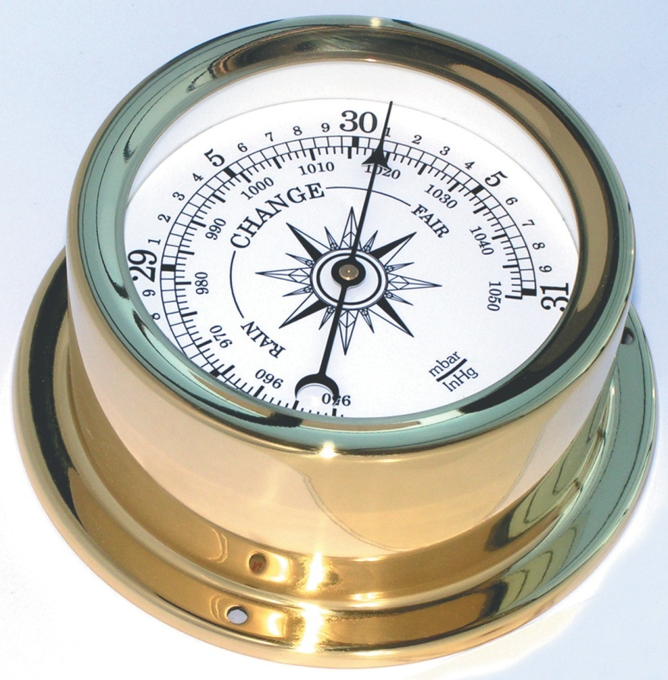
Weather Instruments at Work
Barometer: any instrument that measures air pressure

Slide 34
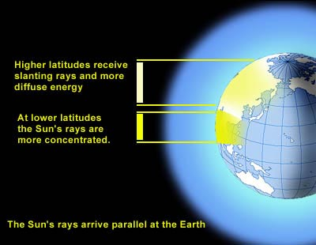
2.2 Why is There Wind?
Is the Earth evenly heated?
Globe/ flashlight example
Less direct sunlight= cooler temperatures
More direct sunlight= warmer temperatures

Slide 35
Wind (Section 1 on RSG, 2-3)
Uneven heating of Earth’s surface causes changes in pressure, which makes air MOVE!
Think back…to the convection currents Warm air RISES, cool air SINKS
Page A 48: Draw the diagram in your notebook – this is a common pattern of air caused by uneven heating of the earth’s surface

Slide 36
Air Pressure and WIND
Have you ever heard a weather forecaster talk about… “LOW PRESSURE” or “HIGH PRESSURE AREAS” when they are predicting the weather?
Handout-!

Slide 37
Coriolis Effect
Textbook Page A 49:
Need: Balloon, marker
Answer the questions in your notebook!
What does this tell you about the Coriolis Effect?
http://www.classzone.com/books/earth_science/terc/content/visualizations/es1904/es1904page01.cfm

Slide 38
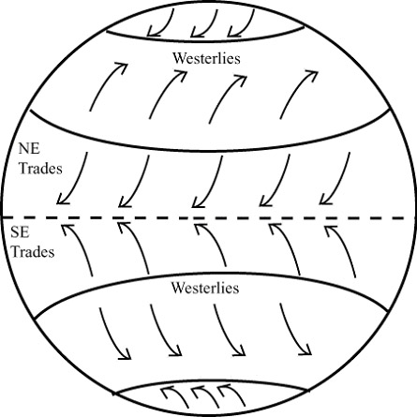
The fact that Earth rotates and it’s surface is unevenly heated mean that there is a PATTERN of global winds and some areas with almost NO wind
http://www.youtube.com/watch?v=Ye45DGkqUkE&feature=related
Global Winds Diagram on the back of your guide…

Slide 39
Diagram A 51
Calm Regions (p. 50)
5. The doldrums are a ____- pressure zone; warm, moist air _________, producing ___________ and ___________. The horse latitudes are __________- pressure zones; cool air _______, producing ________ and _____ weather.

Slide 40
B. Wind Belts (p. 50)
6. The trade winds blow from the _______________ and die out as they come near the _________. The westerlies blow from the ________ and move _________across the United States. The easterlies blow from the _________ and cause stormy weather to occur when _________ from this belt meets warm air of the westerlies.

Slide 41
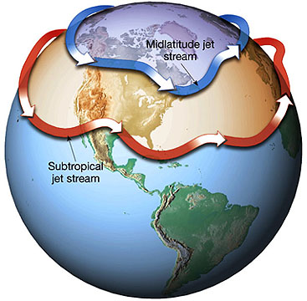
Jet Streams
Not all winds travel along the surface of the Earth

Slide 42
Land and Sea Breezes
See Foldable

Slide 43
Fronts
http://www.classzone.com/books/earth_science/terc/content/visualizations/es2002/es2002page01.cfm
http://www.phschool.com/atschool/phsciexp/active_art/weather_fronts/

Slide 44
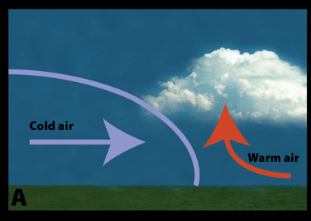
Fronts
Cold Front→ Cold air pushes warm air which forces the warm air to rise. The warm air condenses and forms tall clouds

Slide 45
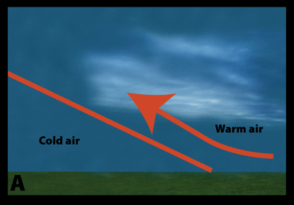
Fronts
Warm Front→ warm air pushes cold air. Warm air rises over cold air and condenses into flat clouds

Slide 46
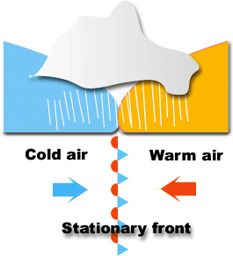
Fronts
Stationary Front→ Two air masses push against each other without moving. Becomes either a cold or warm front when one mass moves forward

Slide 47
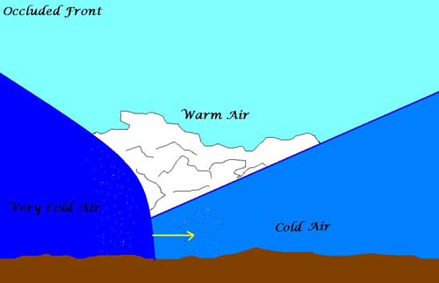
Fronts
Occluded Front→ Cold air overtakes a cold front and warm air is pushed upwards
(produces much less extreme weather)

Slide 48
http://app.discoveryeducation.com/search?Ntt=weather+fronts
VIDEO CLIP
Air masses and fronts: how weather moves from one place to another

Slide 49
Fronts Diagrams
DRAW and WRITE the names of all 4 fronts diagrams
Cold front, warm front and stationary front→ page 83 in science textbook
Occluded front→ page 38 in little blue book

Slide 50
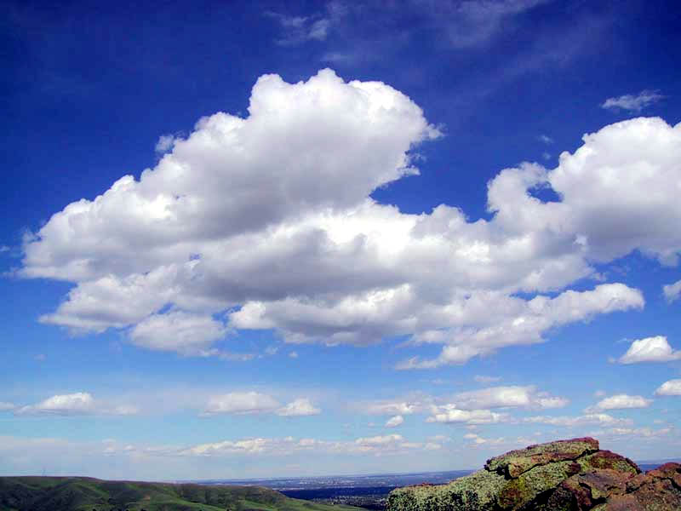
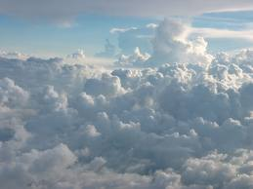
Types of Clouds
Cumulus
Puffy white with dark base
Usually appears in daytime in fair weather
Produces precipitation if they keep growing taller

Slide 51
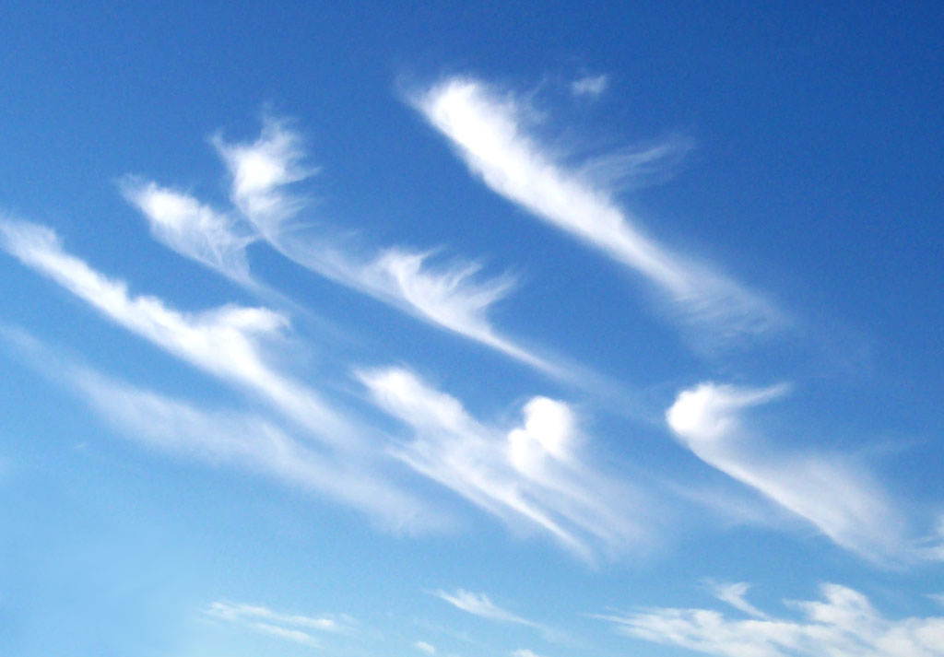
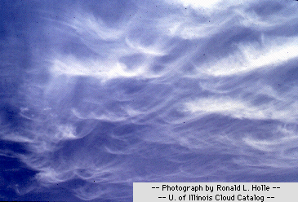
Cirrus
Feathery or wispy looking
Made of ice crystals
Form in very cold air at high altitudes

Slide 52
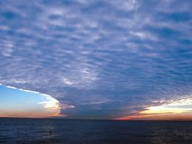
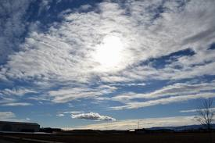
Stratus
Look smooth
Form in layers when air cools over a large area
Produces steady, light precipitation

Slide 53
Cloud Formation Sequence
Air is warmed and expands
Warm air rises
Air cools to its dew point
Water vapor condenses onto solid particles in the atmosphere
A cloud is formed

Slide 54
How do you read a Weather Map??
Uses symbols (see worksheet, textbook)
Refer to handout, textbook, and symbol keys
Complete Weather map handout

Slide 55
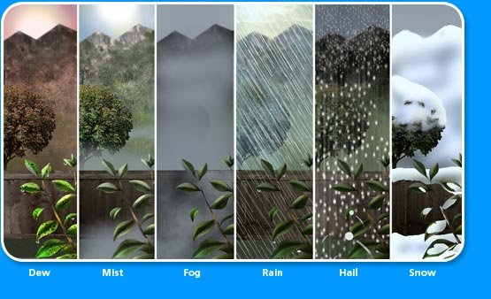
http://www.youtube.com/watch?v=9knozomoMUU
Fronts can cause PRECIPITATION

Slide 57
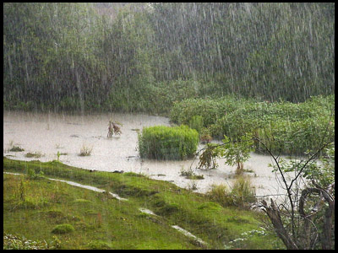
Precipitation Foldable
Precipitation: When cloud particles become too heavy to remain in the air, they fall to the earth as precipitation

Slide 58
Precipitation Foldable
Use info in yellow textbook
Follow all instructions
Find the DEFINTION for RAIN GAUGE and write inside the middle of your foldable

Slide 59
Wild Weather: Storms!
Storm: violent disturbance in the atmosphere
Sudden changes in air pressure
Rapid air movements

Slide 60
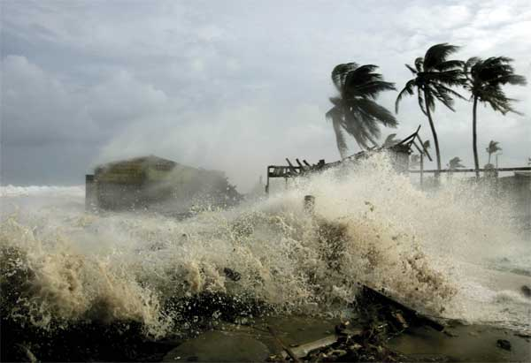
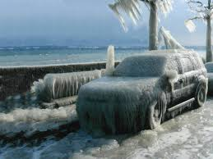
Storms
Hurricanes
Tornadoes
Blizzards
Thunderstorms
Lake-effect snowstorms (mostly in the Great Lakes Region)
Ice storms

Slide 61
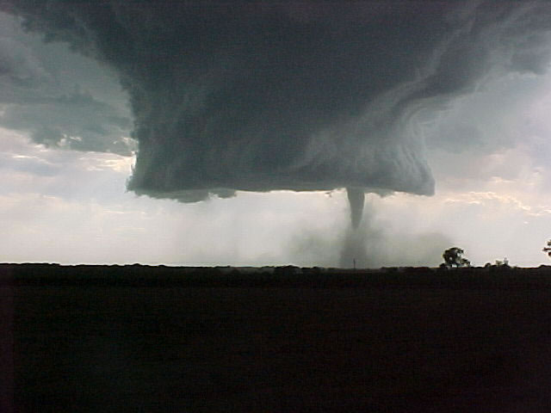
Tornado
A violently rotating column of air (vortex), hanging from a cumulonimbus cloud, with circulation that touches the surface of the earth

Slide 62
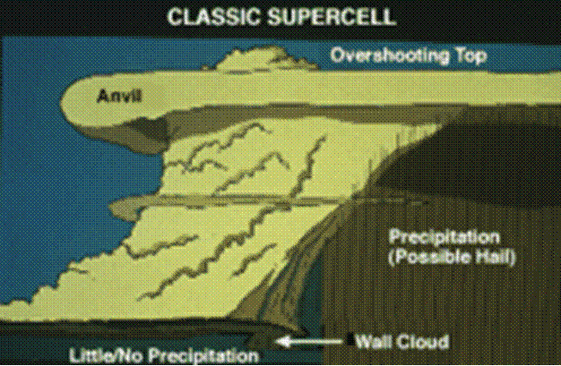
The Supercell
Tornado forms here

Slide 63
Tornados form from thunderstorms which contain one or more updrafts (upward moving air which is warm and moist).
These updrafts form towering cumulonimbus clouds which race upward and cool to form ice crystals (once they reach the anvil of the thunderstorm).
Severe thunderstorms, which is an intense thunderstorm with winds of at least 60 mph, most likely produce tornadoes.
Tornado 101

Slide 64
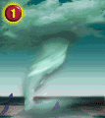
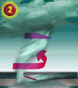
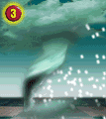
Tornado Formation
Notes:
Tornados form from thunderstorms which contain one or more updrafts (upward moving air which is warm and moist). These updrafts form towering cumulonimbus clouds which race upward and cool to form ice crystals (once they reach the anvil of the thunderstorm). Downdrafts of cold air aloft also occur as the thunderstorm intensifies.
Severe thunderstorms, which is an intense thunderstorm with winds of at least 60 mph, most likely produce tornados.
Tornados form from thunderstorms which contain one or more updrafts (upward moving air which is warm and moist). These updrafts form towering cumulonimbus clouds which race upward and cool to form ice crystals (once they reach the anvil of the thunderstorm). Downdrafts of cold air aloft also occur as the thunderstorm intensifies.
Severe thunderstorms, which is an intense thunderstorm with winds of at least 60 mph, most likely produce tornados.
A thunderstorm capable of producing a tornado requires key ingredients such as: warm moist air, cold air aloft, sometime of wind shear(provides vertical motion) and instability high in the atmosphere, and a trigger.
Tornadic thunderstorms usually occur where cold fronts clash with warm fronts over the Southern Great Plains.
Rising updrafts begin to rotate as wind speed changes with direction and height in the thunderstorm. Along the surface of the earth a horizontal rotating column of air is moved vertically to form a shaft which rotates up through the thunderstorm. This area is where most tornados form.
At some point this rotation becomes so intense that a rotating wall cloud descends from the thunderstorm eventually forming a vortex known as a funnel.
This funnel extends downward to the ground where it is officially deemed a tornado
Tornados often are spawned by large thunderstorms known as a mesocylclone
A mesocyclone is a violent thunderstorm in which the entire storm or cell complex is rotating, which gives it a predisposition to produce tornados
Mesocyclonic thunderstorms are also known as “supercells”

Slide 65
Tornado Categories
The Fujita-Pearson Tornado Intensity Scale or F-scale ranks tornadoes by their wind speed.
signs of f5
F0- winds 40-72 mph
F1- winds 73-112 mph
F2- winds 113-157 mph
F3 – winds 158-206 mph
F4 – winds 207-260 mph
F5 – winds > 261 mph

Slide 66
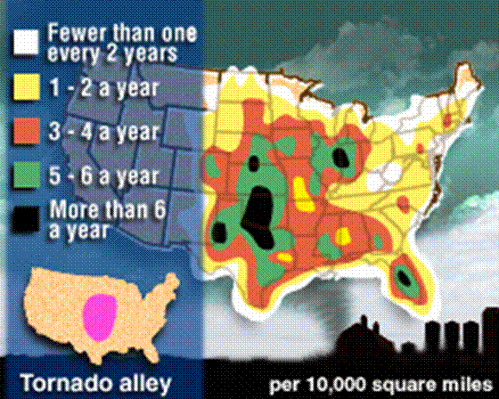
Where Tornadoes Occur
Tornado Alley covers the Great Plains states

Slide 67
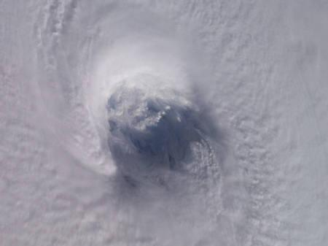
Hurricanes

Slide 68
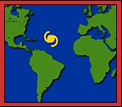
Formation of a Hurricane
Hurricanes = storms that form over tropical waters.
The hurricanes that affect the eastern coast of the United States form off the western coast of Africa where the water is warm, the air is humid, and the winds converge.

Slide 69
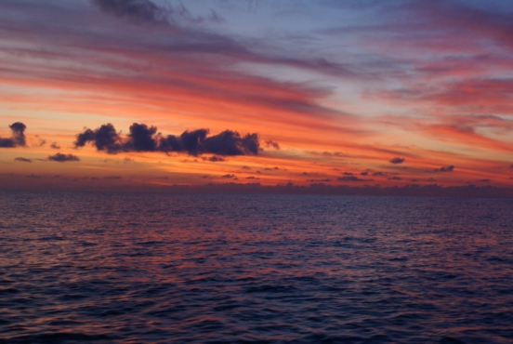
What Causes Hurricanes? http://youtu.be/zP4rgvu4xDE
1. Warm water near the equator evaporates, which moves energy from the water into the air.

Slide 70
What Causes Hurricanes?
2. This energy makes warm air rise faster

Slide 71
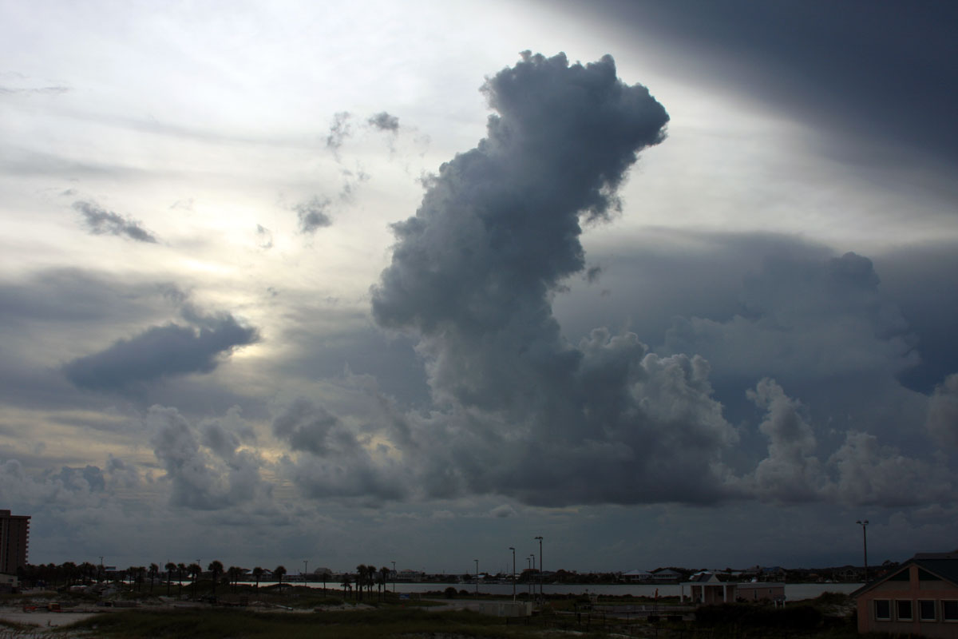
What Causes Hurricanes?
3. Tall Clouds and winds develop

Slide 72
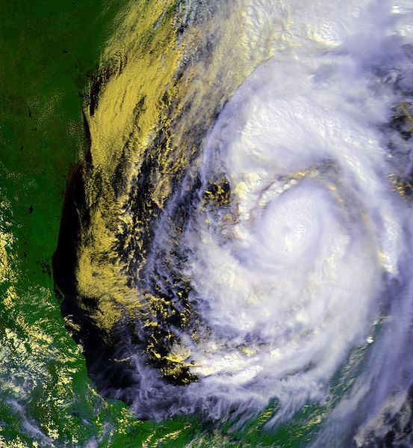
What Causes Hurricanes?
4. The Coriolis Effect bends the winds into a spiral

Slide 73
What Causes Hurricanes?
5. Low pressure area becomes the center of the storm

Slide 74
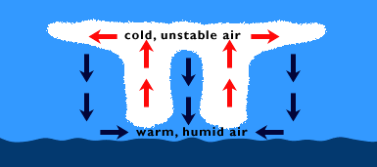
Tropical Disturbance
Hurricanes start out as a group of storms that begin to rotate when they meet converging winds.
These storms create violent seas that send more moisture into the air.
The water vapor rises and helps the wind increase in speed.
If the storm holds itself together for 24 hours, we call it a tropical disturbance.

Slide 75
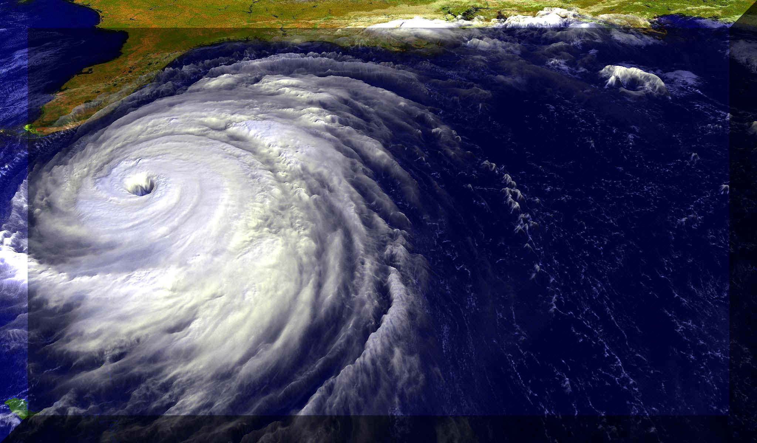
What’s the difference?
Tropical Storm: low pressure system that starts near the equator and has winds that blow at 65 km/hr or more
Hurricane: tropical, low pressure system with winds at 120 km/hr or more

Slide 76
Hurricane Categories
Category 1 – Winds between 74- 95 mph
Category 2 – Winds between 96- 110 mph
Category 3 – Winds between 111-130 mph
Category 4 – Winds between 131-155 mph
Category 5 – Winds above 156 mph

Slide 77
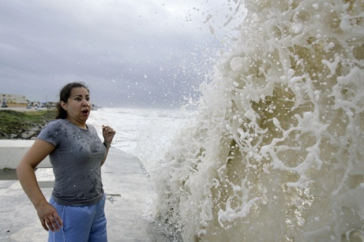
Storm Surge: a rapid rise in water level in a coastal area that occurs when a hurricane pushes a huge mass of water.

Slide 78
Human Body Review pt. 1
Work on it now
Due next class for a GRADE
You will receive Human Body Review pt. 2 next class

