Slide 1
Speed
Objective:
SWBAT calculate speed
WARM UP:
Sky Dive!
Watch the video clip
Write down all the forces that are at work throughout the video clip
Notes:
1

Slide 2
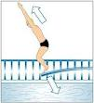
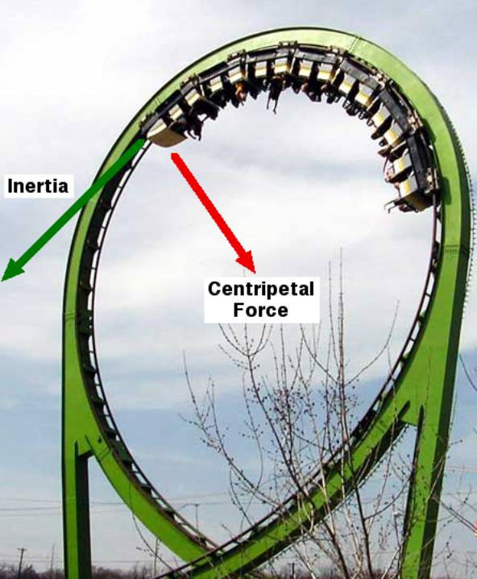
Forces
We will be studying FORCES and MOTION for this quarter (physics, basically)
Relative motion
Speed
Velocity
Acceleration
Gravity
Newton’s laws…………… and SO MUCH MORE

Slide 3
Starting with the Basics: Motion
Motion: the change of position over time
(Position of a place or object is the location of that place or object)

Slide 4
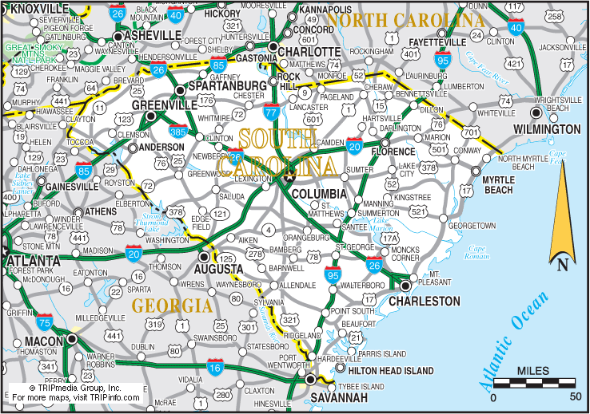
How Do you Describe an object or place’s “position?”
You might describe a position of an object or person based off another object, place or person
Reference Point: a location to which you compare other locations
Example: Charleston, SC is 209 miles southeast from Charlotte, NC

Slide 5
Relative Motion
One way to describe motion involves relative motion
Question: as you are sitting in your chair, are you moving?

Slide 6
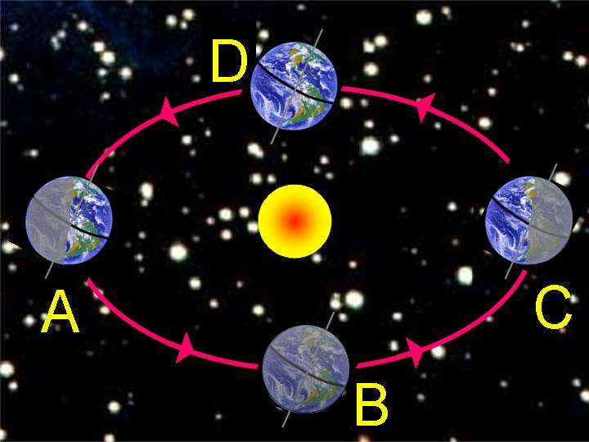
Relative Motion
Answer: it depends on the position and motion of the person who is observing you!
IF… I Am the Observer, then you are not in motion
IF…I Am on the moon and looking at Earth.. You ARE moving (along with Earth as it travels around the sun)
relative motion visualization

Slide 7
Speed
If we know where a person or object’s POSITION is, we can determine how FAST they change positions…. This is SPEED

Slide 8
Speed: a measure of how fast something moves-- or the distance it moves, in a given amount of time
Example: 35 mph
35 miles/1 hr

Slide 9
Speed, Distance, Time Formulas you can calculate speed, distance, or time using the same formula Speed= distance/time (Velocity= Distance/time) velocity is speed in a certain direction

Slide 10
Calculating Speed Given Distance & Time
1. Mrs Poole’s dog ran 10 meters in 5 seconds. What was his speed?
Divide Distance by Time
Distance ÷ Time = Speed
Speed = Distance ÷ Time

Slide 11
Calculating Distance Given Speed & Time
2. Mrs. Poole’s dog ran at a speed of 5 m/s for 5 seconds. HOW FAR DID HE RUN?
Multiply Speed and Time
Distance = Speed X Time
Speed X Time = Distance

Slide 12
Calculating Time Given Distance and Speed
3. Mrs. Poole’s dog ran towards a cat 20 meters away at a speed of 4 m/s. HOW LONG DID IT TAKE HIM TO GET THERE?
Divide Distance by Time
Distance ÷ Speed = Time
Time = Distance ÷ Speed

Slide 13
Practice
If a car travels 400 meters in 20 seconds how fast is it going?
2. You arrive in my class 45 seconds after leaving math class which is 90 meters away. How fast did you travel?
(based off your speed, do you think you’re running or walking?)

Slide 14
Speed: Reading Study Guide
Reinforce your new knowledge of SPEED
Use the yellow textbooks to fill out the worksheet
You are responsible for knowing all the information on the worksheet

Slide 15
Bill Nye: Motion
Fill out ALL answers on your worksheet
https://www.youtube.com/watch?v=UcLy6Fqhwsg

