Slide 1
Reminder!
**Test next class**
Covering genetics
Study Study Study!

Slide 2
Test Review
Objective:
SWBAT review genetics in preparation for a test
WARM UP:
What does DNA stand for? (hint hint..you may see this as a bonus)
Notes:
2

Slide 3
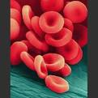
(1st block) Blood Typing
What determines our blood type?
Your blood type is inherited from your mom and dad- like your eye color and hair color and skin color
Why does it matter? Isn’t all blood red? Isn’t it all made of red blood cells? Wouldn’t it be the same?!

Slide 4
Blood types
Both the allele for A and the allele for B are CODOMINANT: When both are inherited, both are expressed
Example: kid who inherits a B blood allele and an A blood allele will have group AB blood
Type O blood is recessive, so for a kid to have O blood they would have the alleles OO

Slide 5
Negative/Positive Blood types?
Your blood type= tiny protein markers on the surface of all of your blood cells
Two main types: the ABO group and the “Rh factor”
ABO= type of blood (A, B, AB, O)
Rh factor= positive (+) or negative (-) blood

Slide 6
Write in your notebook: Blood Group Alleles
Blood Groups | Combination of Alleles
A | AA or AO
B | BB or BO
AB | AB
O | OO

Slide 7
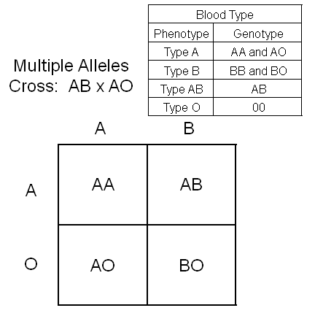
One parent with AB blood
One parent with Type A Blood (so either genotype AA or AO)
You would need to do two Punnett squares- the other Punnett Square should use AA instead of AO

Slide 8
Let’s do an example
Possible blood types of child born to
Parent with type B blood
Parent with type AB blood
Blood Groups | Combination of Alleles
A | AA or AO
B | BB or BO
AB | AB
O | OO
These would be the alleles you’d use with a Punnett square

Slide 9
A Quick Switch?
Who can read the opening paragraph?
Let’s do #1 and #2 together

Slide 10
1. What is Mrs. Bright’s phenotype?
What possible genotypes can Mrs. Bright have?
2. What is Mr. Bright’s phenotype?
What possible genotypes can Mr. Bright have?

Slide 11
A Quick Switch!
Work with your partner to answer all questions and solve the mystery of the Light and Bright families

Slide 12
Why do certain people get called to give blood more often?
Blood type A can only be given to type A and AB patients.
Blood type B can only be given to type B and AB patients.
Blood type AB individuals can receive blood from everyone, but they can only donate to other AB blood type patients.
Blood type O individuals can only receive type O blood, but they can donate blood to every other type.

Slide 13
Study Guide (20 minutes)
Fill out in groups
If you are finished, STUDY and quiz each other
-genetics vocab
-punnett squares
-cell reproduction
-cell division (stages of mitosis and meiosis)
-reading a pedigree

Slide 14
Tying it all together (20 minutes)
Foldable
DRAW each picture before you cut out the strips
Gene: page C 102
DNA: page C 75
Chromosome: page C 75
Nucleus: page C 75
Animal cell: page C 22
Tissue, organ, human: see example on page B 11

Slide 15
Vocabulary Review (15 minutes)
Review Toss!
DON’T hit each other with the ball
Extra points for questions you get right

Slide 16
The other name for homozygous.. Having two of the same form of genes

Slide 17
process that your cells use to reproduce (make new cells)

Slide 18
How many TOTAL chromosomes do humans have?

Slide 19
Is when a parent organism develops a tiny bud on its body. The bud is genetically identical to the _parent__ organism. The _bud_ grows until it gets large enough to break off the parent organism and live independently.

Slide 20
The phase of mitosis where a cell is carrying out its normal everyday processes before mitosis begins

Slide 21
The alternate forms of one gene, example of B or b for hair color

Slide 22
This part of the cell houses DNA and it the control center of the cell

Slide 23
A sperm or egg cell containing half the usual number of chromosomes of an organism

Slide 24
This describes the allele that determines the phenotype (physical traits) of an organism when there are two different copies in the genotype

Slide 25
This monk experimented with sweet pea plants and is called the Father of Genetics

Slide 26
This term describes an allele that is not seen when combined with a dominant form of the same gene

Slide 27
The passing of genes from parents to offspring

Slide 28
The OBSERVABLE characteristics or traits of an organism

Slide 29
The GENETIC makeup of an organism

Slide 30
The structures in a cell that contain the DNA (cells genetic material)

Slide 31
Chart that shows possible gene combinations

Slide 32
The basic unit of heredity that consists of a segment of DNA on a chromosome

Slide 33
What would the punnett square look like for a mother with hybrid brown hair and a father with pure brown hair? Draw it out!

Slide 34
What is the process by which an EXACT GENETIC copy is made of an organism?

Slide 35
What is the name of the cell division process that produces the gametes (sex cells) with HALF the amount of chromosomes of a normal human cell?

Slide 36
This is the name of the chart that shows how a trait or disorder has passed from one generation to the next generation

Slide 37
On a pedigree, the MALES are represented by WHAT SHAPE?

Slide 38
This type of trait can occur in blood type- when two different alleles are equally dominant. What is this called?

Slide 39
What Questions Do You Have?
Anything need clarification?

Slide 40
STUDY (remainder of class)
Use this time to STUDY
Quiz each other! Make notecards for vocabulary!

