Slide 1
Energy Transfer and Simple Machines
Objective:
SWBAT explain transfer of energy and review simple machines
Warm Up:
List different forms of energy
Notes:
1

Slide 2
Nature of Energy
What is energy that it can be involved in so many different activities?
Energy can be defined as the ability to do work.
If an object or organism does work (exerts a force over a distance to move an object) the object or organism uses energy.

Slide 3
Questions We are Answering Today
What are the main types of energy?
2. What is Energy Transfer?
3. What is the Law of Conservation of Energy and how does it apply?

Slide 4
Energy: Forms and Changes

Slide 5
Forms of Energy
Main forms of energy include:
Mechanical
Chemical
Thermal (heat)
Electromagnetic
Nuclear
Electrical

Slide 6
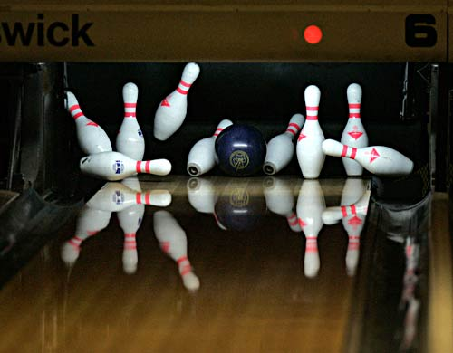
What is Mechanical Energy?
Energy due to a object’s motion (kinetic) or position (potential).
The bowling ball has mechanical energy.
When the ball strikes the pins, mechanical energy is transferred to the pins!

Slide 7
Examples of Mechanical Energy

Slide 8
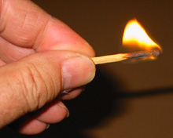
What is Chemical Energy?
Energy that is available for release from chemical reactions.
The chemical bonds in a matchstick store energy that is transformed into thermal energy when the match is struck.

Slide 9
Chemical Energy
Fuel and food are forms of stored chemical energy.

Slide 10
Examples of Chemical Energy

Slide 11
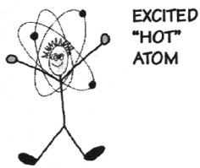
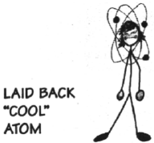
What is Thermal Energy?
Heat energy
The heat energy of an object determines how active its atoms are.
A hot object is one whose atoms and molecules are excited and show rapid movement.
A cooler object's molecules and atoms will show less movement.

Slide 12
Electromagnetic Energy
Light energy
Each color of light (Roy G Bv) represents a different amount of electromagnetic energy.
also carried by X-rays, radio waves, and laser light.

Slide 13
Electromagnetic Energy
Power lines carry electromagnetic energy into your home in the form of electricity.

Slide 14
Nuclear Energy
The nucleus of an atom is the source of nuclear energy.
The sun’s energy is produced from nuclear energy

Slide 15
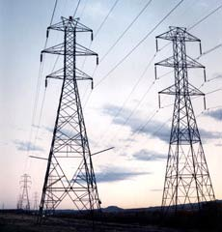
What is Electrical Energy?
Energy caused by the movement of electrons
Easily transported through power lines and converted into other forms of energy

Slide 16
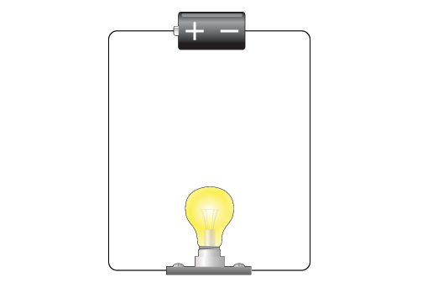
Electrical Energy at work
Batteries store chemical energy and transfer it to components in an electrical circuit.
This chemical energy is converted into electrical energy.
Circuits have to have a complete loop for an electrical current to pass through.
*demonstration

Slide 17
What type of energy cooks food in a microwave oven?
ELECTROMAGNETIC ENERGY
What type of energy is the spinning plate inside of a microwave oven?
MECHANICAL ENERGY

Slide 18
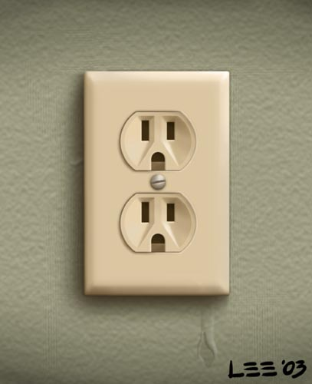
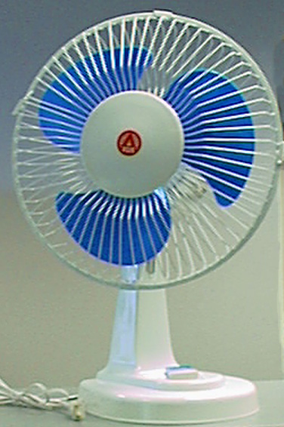
Electrical energy is transported to your house through power lines.
When you plug an electric fan to a power outlet, electrical energy is transform into what type of energy?
MECHANICAL ENERGY

Slide 19
Energy Transfer
Energy can be changed from one form to another.
Changes in the form of energy are called energy transfer.

Slide 20
What types of energy are shown below?
Chemical,Electrical, Mechanical and
Electromagnetic Energy

Slide 21
Energy Transformation Practice
Worksheet
Help each other if needed

Slide 22
States of Energy
The most common energy conversion is the conversion between potential and kinetic energy.
Remember…all forms of energy can be in either of two states:
Potential
Kinetic

Slide 23
Kinetic-Potential Energy Conversions
As a basketball player throws the ball into the air, various energy conversions take place.

Slide 24
(Gravitational)
Ball slows down
Ball speeds up

Slide 25
Energy conversions
All forms of energy can be converted into other forms.

Slide 26
Energy Conversions
In a car engine, fuel is burned to convert chemical energy into heat energy. The heat energy is then changed into mechanical energy.

Slide 27
Chemical → Thermal→ Mechanical

Slide 28
Question 3
Law of the Conservation of Energy:
No matter how the energy is transferred (passed on) or transformed (changed), all of that energy still exists in some form
http://www.youtube.com/watch?v=qybUFnY7Y8w

Slide 29
Simple Machines Handout (from last class)
*see front of handout
What did you write?

Slide 30
Simple Machines
6 Simple machines handout
You explored 6 types of simple machines
What were they?

Slide 31
The 6 Simple Machines
Inclined Plane
Screw
Wedge
Pulley
Wheel and Axle
Lever

Slide 32
What is a Simple Machine?
A simple machine has few or no moving parts.
Simple machines make work easier

Slide 33
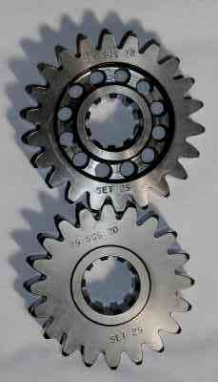
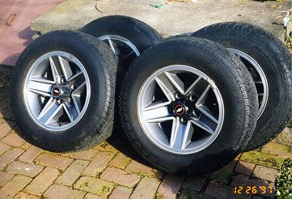
Wheels and Axles
The wheel and axle are a simple machine
The axle is a rod that goes through the wheel which allows the wheel to turn
Gears are a form of wheels and axles

Slide 34
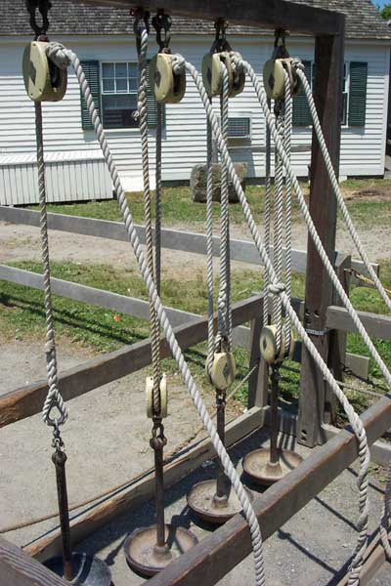
Pulleys
Pulleys are wheels and axles with a groove around the outside
A pulley needs a rope, chain or belt around the groove to make it do work

Slide 35
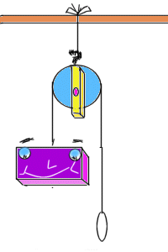
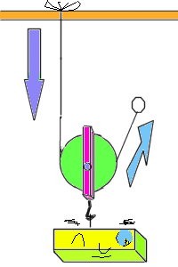
Diagrams of Pulleys
Fixed pulley:
A fixed pulley changes the direction of a force; however, it does not create a mechanical advantage.
Movable Pulley:
The mechanical advantage of a moveable pulley is equal to the number of ropes that support the moveable pulley.

Slide 36
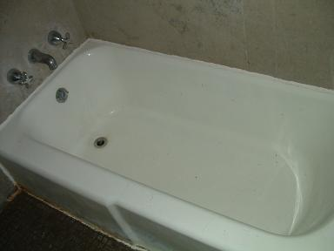
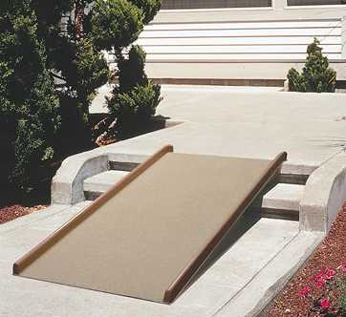
Inclined Planes
An inclined plane is a flat surface that is higher on one end
Inclined planes make the work of moving things easier
Notes:
A sloping surface, such as a ramp. An inclined plane can be used to alter the effort and distance involved in doing work, such as lifting loads. The trade-off is that an object must be moved a longer distance than if it was lifted straight up, but less force is needed. You can use this machine to move an object to a lower or higher place. Inclined planes make the work of moving things easier. You would need less energy and force to move objects with an inclined plane.

Slide 37
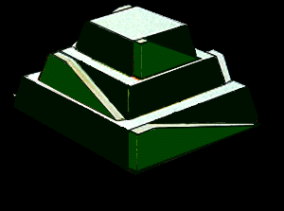
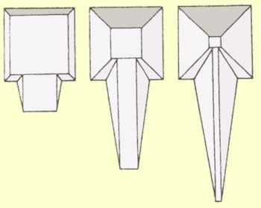
Inclined Plane
The Egyptians used simple machines to build the pyramids. One method was to build a very long incline out of dirt that rose upward to the top of the pyramid very gently. The blocks of stone were placed on large logs (another type of simple machine - the wheel and axle) and pushed slowly up the long, gentle inclined plane to the top of the pyramid.

Slide 38
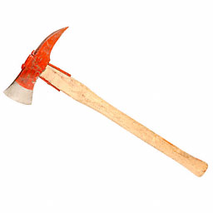
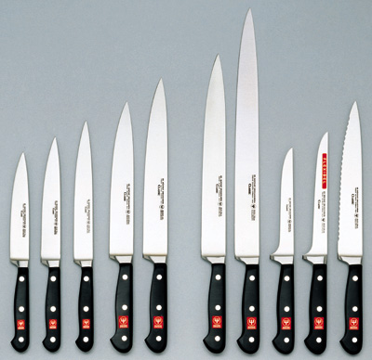
Wedges
Two inclined planes joined back to back.
Wedges are used to split things.

Slide 39
Screws
A screw is an inclined plane wrapped around a shaft or cylinder.
The inclined plane allows the screw to move itself when rotated.

Slide 40
Levers (First Class)
In a first class lever the fulcrum is in the middle and the load and effort is on either side
Think of a see-saw

Slide 41
Levers-Second Class
In a second class lever the fulcrum is at the end, with the load in the middle
Think of a wheelbarrow

Slide 42
Levers-Third Class
In a third class lever the fulcrum is again at the end, but the effort is in the middle
Think of a pair of tweezers

Slide 43
Simple Machines
Simple Machines can be put together in different ways to make complex machinery

Slide 44
Energy Transformation Practice
Worksheet
Help each other if needed

