Slide 1
Strawberry DNA and Blood Typing
Objective:
SWBAT extract DNA from strawberries and understand blood typing
WARM UP:
Where is DNA located in a cell?
What is a chromosome?
Notes:
1

Slide 2
The end of the quarter is 3/28…
Any make up work??
Due BY MONDAY

Slide 3
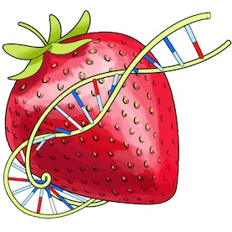
Strawberry DNA
Lab
Purpose
This activity helps you see DNA in strawberries! ALL living things contain DNA

Slide 4
Materials
Strawberry
Sandwich bag
Meat tenderizer
Liquid soap
Small test tube
90% isopropyl alcohol
Water
Filter paper
Funnel
Paper clip
Scissors

Slide 5
Lab design
Independent variable: types of fruit
(you could measure the amount of DNA in strawberries vs. kiwis)
Dependent variable: amount of DNA
The constants: meat tenderizer, soap, alcohol, water

Slide 6
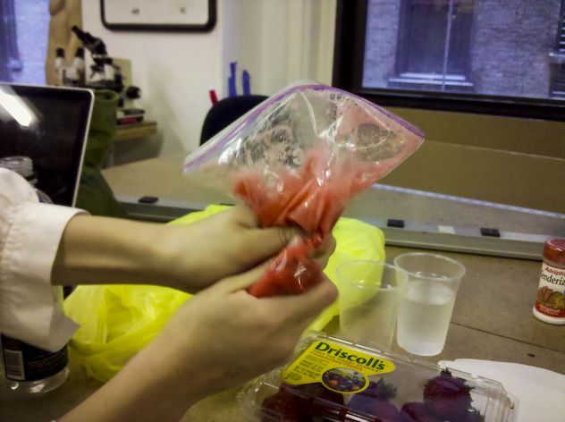
Steps 1-2
Place strawberry into plastic bag and seal
Mash up the strawberry (this breaks down the cell walls of the strawberry cells to get to the nucleus)
DO NOT pop the bag
or you will not get
to finish this lab

Slide 7
Step 3
3. Add 2 pumps of clear liquid soap
Add a pinch of meat tenderizer to the bag
Continue to mix the strawberries and crush into a liquid
PLEASE DO NOT break the bag!

Slide 8
Step 4-5
4. Using the large graduated cylinder, add around 8 mL of water to the bag
5. Mix well- turn it all into a juice
DO NOT POP THE BAG

Slide 9
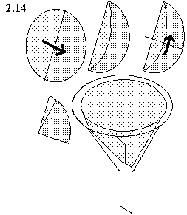
Step 6
6. Cut the coffee filter so you have
a circle of filter paper
Fold paper (see Mrs. Poole for instructions on how)
Place the funnel in the top of the little test tube
(someone should hold the funnel on top of the test tube)

Slide 10
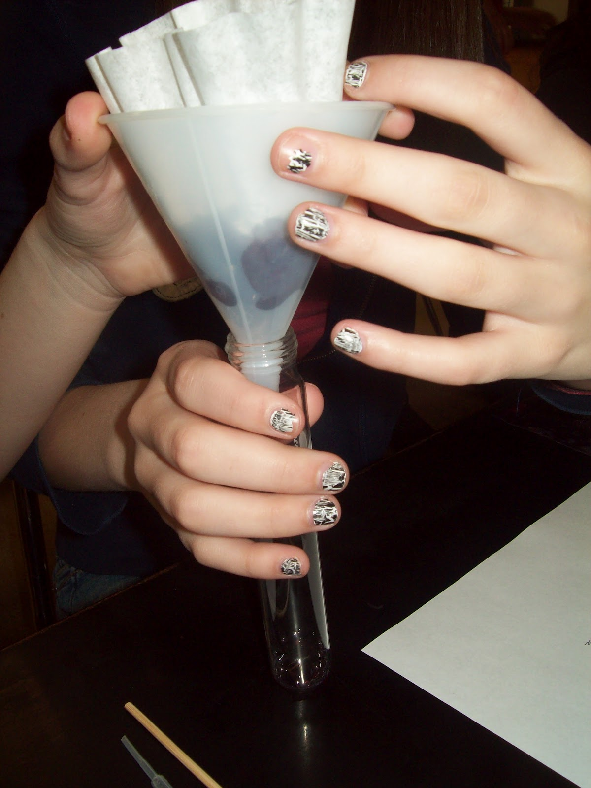
Step 6
Cut a small hole in the bottom of the bag (careful, don’t let anything leak out!)
Squeeze the mixture into the funnel and filter into test tube

Slide 11
Step 7
7. Have one person hold the test tube at an angle
Another person should add 2 mL of cold alcohol over the fruit solution in the tube. Let it flow DOWN the side of the tube, not straight in!

Slide 12
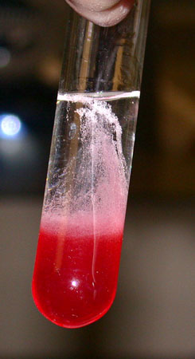
Step 8-9
A slimy light material will form at the bottom of the alcohol. This material is clumps of DNA
Use a straightened paper clip to spool up DNA fibers
Use a slow twirling motion
Do not stick the paper clip down into the strawberry liquid or mix it up

Slide 13
Analysis
Answer 1-2 questions in your notebook!
Why do you think it might be important for scientists to be able to remove the DNA from an organism?
Why does the alcohol added in step 7 float to the top of the juice?

Slide 14
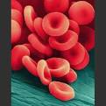
Question
What determines our blood type?
Your blood type is inherited from your mom and dad- like your eye color and hair color and skin color
Why does it matter? Isn’t all blood red? Isn’t it all made of red blood cells? Wouldn’t it be the same?!

Slide 15
Blood types
Both the allele for A and the allele for B are CODOMINANT
When both are inherited, both are expressed
Example: kid who inherits a B blood allele and an A blood allele will have group AB blood
Type O blood is recessive, so for a kid to have O blood they would have the alleles OO

Slide 16
Negative/Positive Blood types?
Your blood type= tiny protein markers on the surface of all of your blood cells
Two main types: the ABO group and the “Rh factor”
ABO= type of blood (A, B, AB, O)
Rh factor= positive (+) or negative (-) blood

Slide 17
Write in your notebook: Blood Group Alleles
Blood Groups | Combination of Alleles
A | AA or AO
B | BB or BO
AB | AB
O | OO

Slide 18
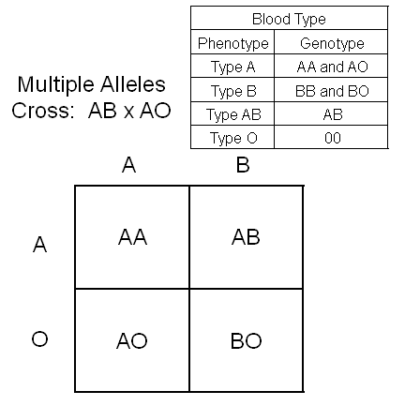
One parent with AB blood
One parent with Type A Blood (so either genotype AA or AO)
You would need to do two Punnett squares- the other Punnett Square should use AA instead of AO

Slide 19
Let’s do an example
Possible blood types of child born to
Parent with type B blood
Parent with type AB blood
Blood Groups | Combination of Alleles
A | AA or AO
B | BB or BO
AB | AB
O | OO
These would be the alleles you’d use with a Punnett square

Slide 20
A Quick Switch?
Who can read the opening paragraph?
Let’s do #1 and #2 together

Slide 21
1. What is Mrs. Bright’s phenotype?
What possible genotypes can Mrs. Bright have?
2. What is Mr. Bright’s phenotype?
What possible genotypes can Mr. Bright have?

Slide 22
A Quick Switch!
Work with your partner to answer all questions and solve the mystery of the Light and Bright families

Slide 23
Why do certain people get called to give blood more often?
Blood type A can only be given to type A and AB patients.
Blood type B can only be given to type B and AB patients.
Blood type AB individuals can receive blood from everyone, but they can only donate to other AB blood type patients.
Blood type O individuals can only receive type O blood, but they can donate blood to every other type.

Slide 24
Tying it all together…
Foldable
DRAW each picture before you cut out the strips
Gene: page C 102
DNA: page C 75
Chromosome: page C 75
Nucleus: page C 75
Animal cell: page C 22
Tissue, organ, human: see example on page B 11

