Slide 2
Genetic Mutations and Pedigrees
Objective:
SWBAT read a pedigree showing genetic traits
WARM UP:
What is your definition of a mutation? (Don’t look it up in the textbook!)
2. What do genes do?
Notes:
2

Slide 3
Review..
Remind me.. What do genes do?
Did you know what just 0.1% variation in your DNA makes you unique? In fact, 99.9% of your DNA is the same as someone else’s DNA!
Errors can occur when DNA is copied and also can be affected by the environment
Mutation: any change in DNA

Slide 4
3 types of Mutations
Who can read?: (page C 145)
So what’s the deal with mutations? Are they always “bad”? Do they produce “mutants?”

Slide 5
Genetic Disorder: disease or condition that results from mutations that affect the normal functions of a cell
Understanding Chromosomal Disorders
Sometimes these are inherited and sometimes the mutations happen during someone’s lifetime (like cancer)
Some disorders are only on an X or a Y chromosome (ex: hemophilia)

Slide 6
Pedigrees show the pattern of inheritance of a genetic disorder
PEDIGREE: diagram of family relationships that includes two or more generations

Slide 7
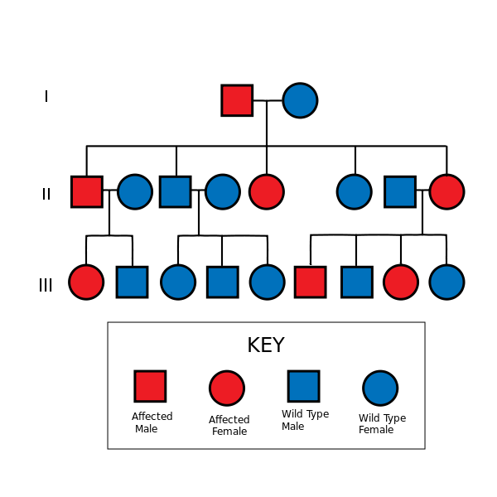
Pedigrees
Men
Women
1st generation
2nd generation
3rd generation

Slide 8
Example
Sickle cell anemia pedigree C 147
When the
are connected, that means they’re married
These are their kids
This means they have kids

Slide 9
Practice!
Working with your partner, complete the pedigree practice sheet
Write all answers
Make sure you look at the key before you begin- you need to know what all the shapes and colors stand for!

Slide 10
A famous pedigree
Page 73 in blue “Heredity” book
Hemophilia history in Europe -> carrying the gene on one X chromosome
Read the first paragraph

Slide 11
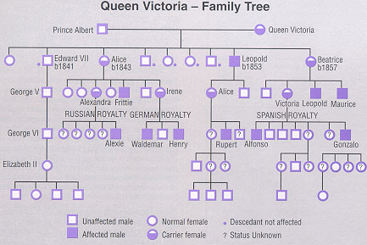
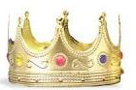
Charles Ann Andrew Edward
William Henry

Slide 12
Living with a Genetic Disorder
Lizzie Velasquez
It can be hard to overcome people’s negative reactions to something you can’t change
Tamilore's Story
1. Write down 2 new things you learned
2. Write down one thing you want to share with your table

Slide 13
Reinforcing
Read C 144- C 148 with your group
Answer questions 3 and 5 at the end of the section. Make sure ALL your group members have the answers for ALL questions!

